Slide 1


Grant no. 12135007
Craig Roberts … http://inp.nju.edu.cn/
Strong Interactions and the Standard Model
Notes:
25+5

Slide 2
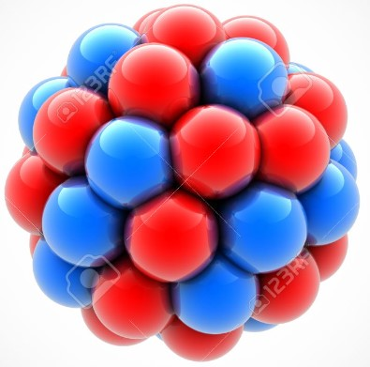
The Nature of Things
Looking at the known Universe, one could be awed by the many complex things it contains.
Even the Earth itself is complicated enough to generate many questions in our minds
Basic amongst them are those which focus on our own existence and composition.
Here, too, there are many levels to be explored, running right down to the nuclei
at the core of every atom and molecule
Even deeper, to the neutrons and protons (nucleons) that constitute those nuclei.
Faced with all this, physicists nevertheless assume that a few simple mathematical rules should be sufficient to provide a complete explanation of everything we can now perceive, and which might become perceptible in future.
This may be correct
Or it might be supreme arrogance = hubris

Slide 3
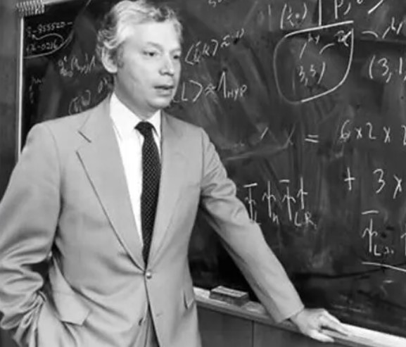
Nature of Physics
Steven Weinberg
Born: May 3, 1933, New York, NY
Died: July 23, 2021, Austin, TX
“The effort to understand the universe is one of the very few things that lifts human life a little above the level of farce and gives it some of the grace of tragedy.”
“Nothing in the last five hundred years has had so great an effect on the human spirit as the discoveries of modern science.”
“I know of no one who has participated actively in the advance of physics in the postwar period whose research has been significantly helped by the work of philosophers.”
“Science is the path to truth”

Slide 4

Basic Question:
How did we get here?

Slide 5


Slide 6
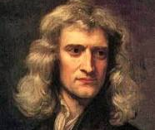
Great Unifications
“First Great Unification" – Isaac Newton – 350 years ago
Universal Law of Gravitation
A person, fixed on earth, realised that all objects attract each other with a force of gravitational attraction, no matter where they are in the Universe.
Unified the understandings of the observable phenomena of gravity on Earth with the observable behaviour of celestial bodies in space

Slide 7
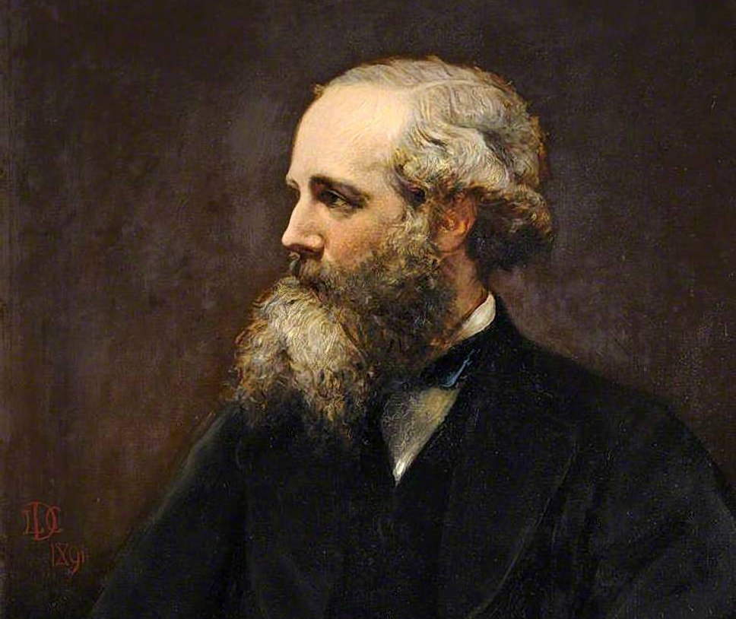
Great Unifications
“Second Great Unification" – 155 years ago – James Clerk Maxwell
Formulated the classical theory of electromagnetic radiation, unifying electricity + magnetism + light
as different manifestations of the same
phenomenon.
“A Dynamical Theory of the Electromagnetic Field” – 1865
Demonstrated that electric and magnetic fields travel through space as waves moving at the speed of light.
Unification of light and electrical phenomena led to Maxwell’s prediction of the existence of radio waves.

Slide 8
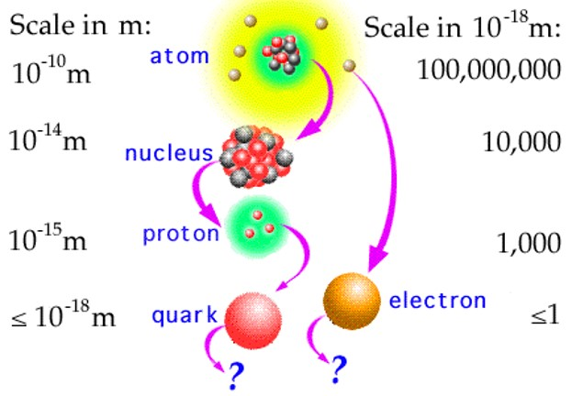
Great Unifications
“Third Great Unification" – Standard Model of Particle Physics
1967 – S. Weinberg “A Model of Leptons”
∼ 14,800 citations
“The most successful theory ever conceived …”
All particles predicted to exist have been found.
The masses of those particles lie within 1% of the theoretical values anticipated by the model.
55 Nobel Prizes awarded for key developments and discoveries
Description of all known fundamental physics except for gravity, and gravity has no detectable effect when particles are studied a few at a time.

Slide 9
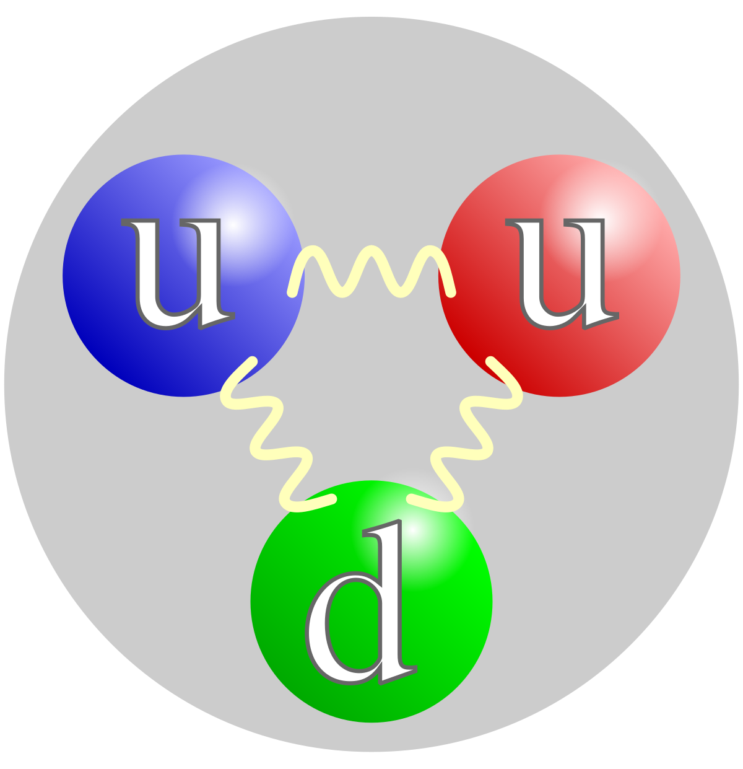
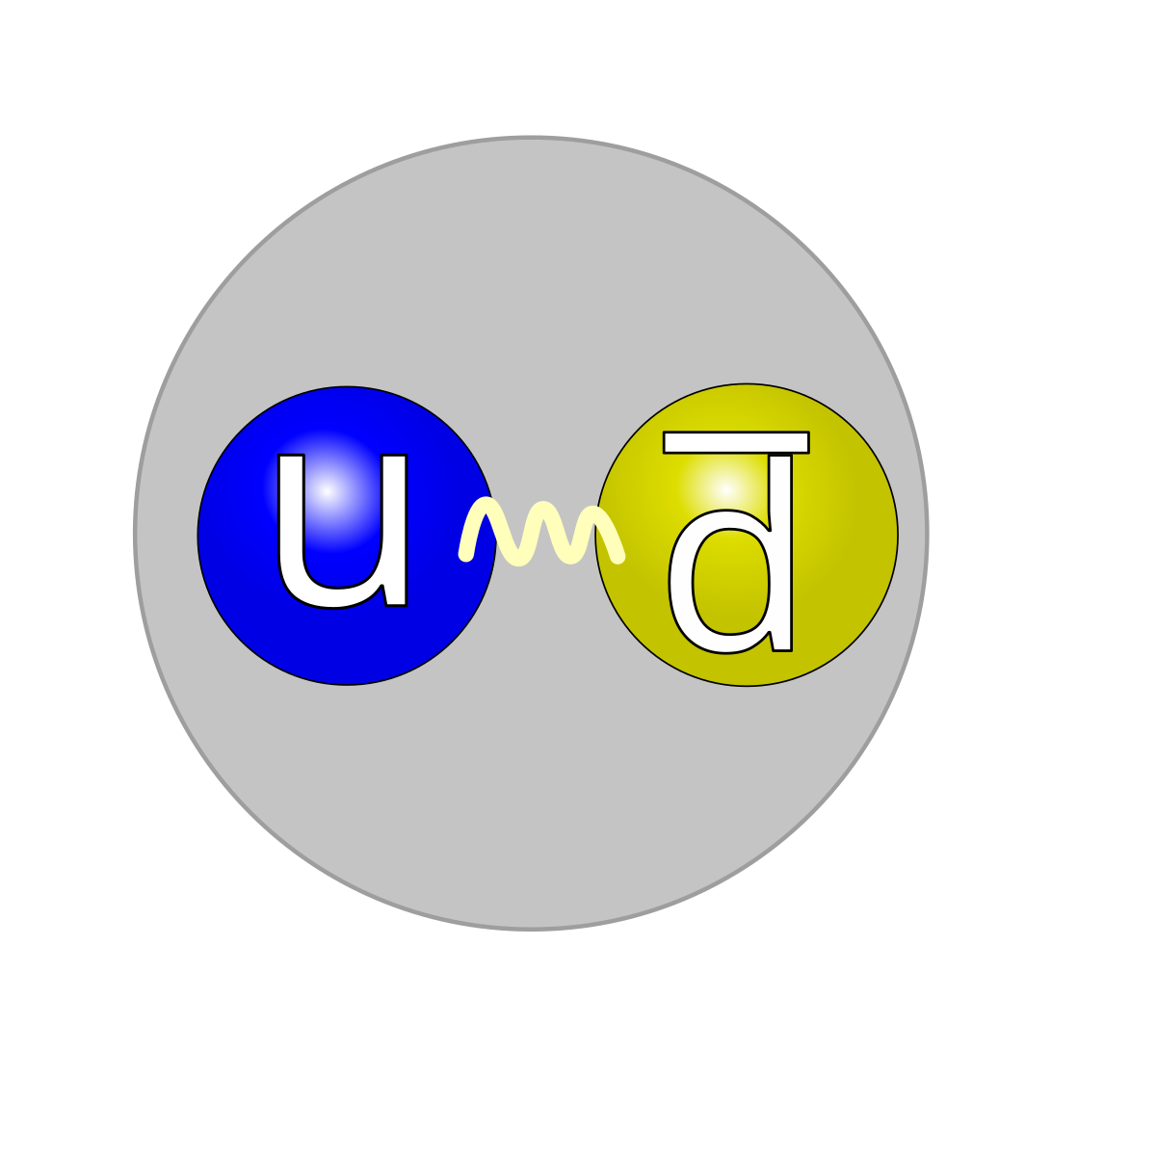
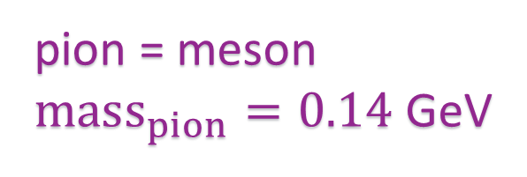
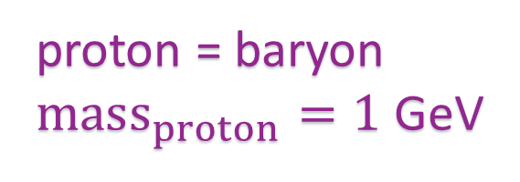
Standard Model - History
In the early 20th Century, the only particles of matter known to exist were the proton, neutron, and electron.
Pion discovered in 1947
For the everyday physicist …
Basic questions:
what do these (quark model) pictures mean?
are they realistic in any sense?
why is pion mass so much smaller than proton mass?
what theory can explain these systems?
pion = meson
$mass_{pion}=0.14$ GeV
proton = baryon
$mass_{proton}=1$ GeV

Slide 10
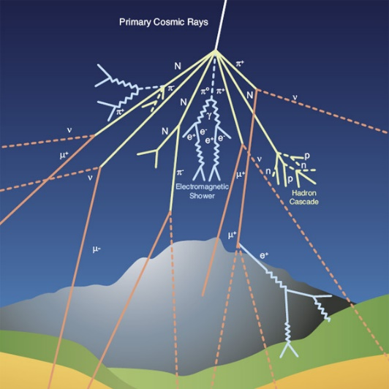
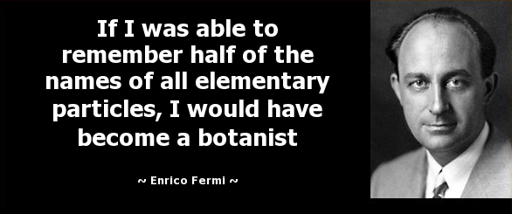
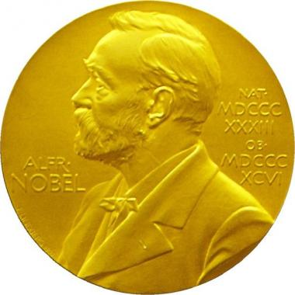
Standard Model - History
In the early 20th Century, the only particles of matter known to exist were
the proton, neutron, and electron.
With the advent of cosmic ray science and particle accelerators, numerous additional particles were discovered:
muon (1937), pion (1947), kaon (1947), rho-meson – pion excitation (1961),
Roper resonance – nucleon excitation (1963), …
By the mid-1960s, it was apparent that not all the particles could be fundamental.
A new paradigm was necessary.
Constituent-quark theory (1964) of Gell-Mann and Zweig, independently, was a crucial step forward.
Gell-Mann, Nobel Prize 1969: "for his contributions and discoveries concerning the classification of elementary particles and their interactions".
Nobel Prize 1938 “for his demonstrations of the existence of new radioactive elements produced by neutron irradiation, and for his related discovery of nuclear reactions brought about by slow neutrons”

Slide 11
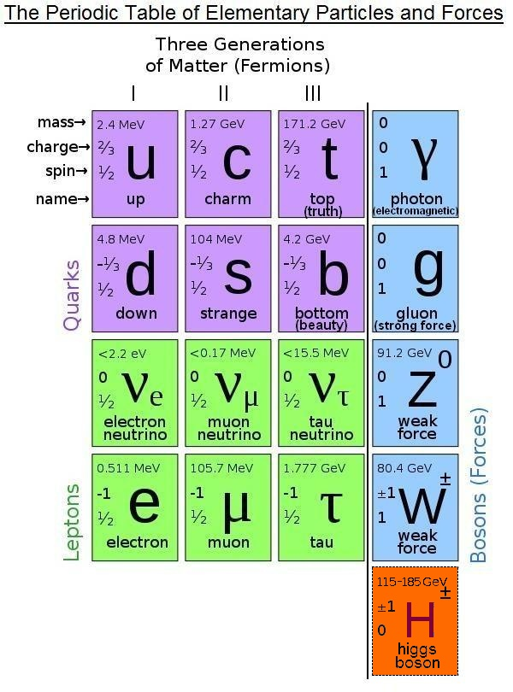
Standard Model of Particle Physics
Supposed to explain and unify all the forces of Nature, except Gravity
125
13 years ago

Slide 12
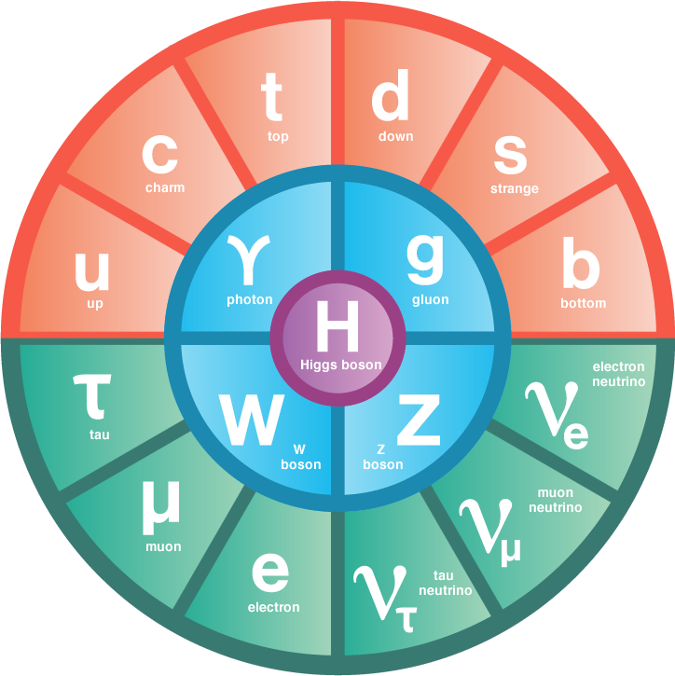
Standard Model of Particle Physics
Standard Model (SM) offers a description of all known fundamental physics except gravity, and gravity is something that has no discernible effect when particles are studied a few at a time.
Since LHC’s discovery of the Higgs in 2012, the Higgs Boson has been promoted to the
Centre of Things
Standard Model has
17 particles and 19 parameters,
most of which relate to the Higgs and all of which must be determined through comparison with experiment
SM supposedly describes most powerful forces in Nature; yet, somewhat unsatisfactory

Slide 13
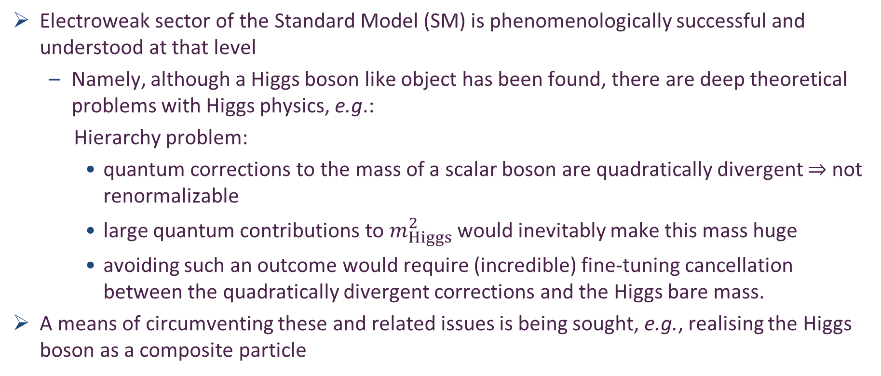
Standard Model of Particle Physics
Electroweak sector of the Standard Model (SM) is phenomenologically successful and understood at that level
Namely, although a Higgs boson like object has been found, there are deep theoretical problems with Higgs physics, e.g.:
Hierarchy problem:
quantum corrections to the mass of a scalar boson are quadratically divergent $⇒$ not renormalizable
large quantum contributions to $m_{Higgs}^{2}$ would inevitably make this mass huge
avoiding such an outcome would require (incredible) fine-tuning cancellation between the quadratically divergent corrections and the Higgs bare mass.
A means of circumventing these and related issues is being sought, e.g., realising the Higgs boson as a composite particle
G. Cacciapaglia, C. Pica, F. Sannino, Fundamental Composite Dynamics: A Review, Phys. Rept. 877 (2020) 1–70.

Slide 14
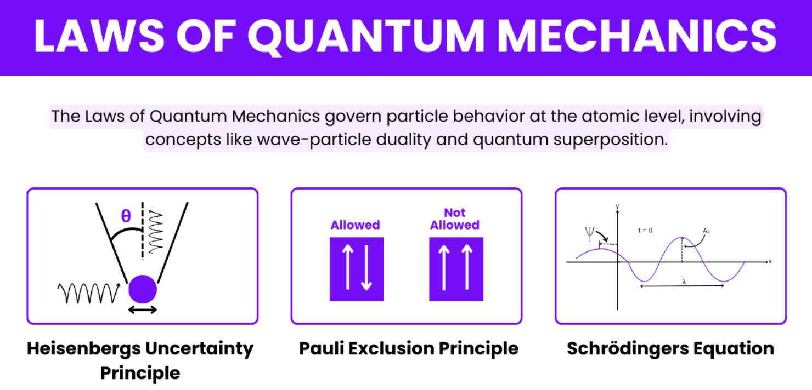

Slide 15
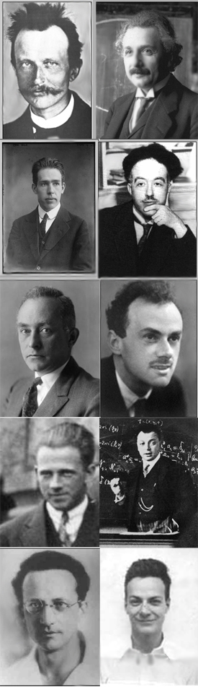
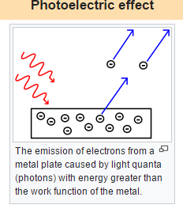
What is Quantum?
Inventors of Quantum Mechanics
Albert Einstein
Nobel Prize for explaining the photoelectric effect
1905 (prize 1921)
electromagnetic waves → photons
“According to the assumption to be contemplated here, when a light ray is spreading from a point, the energy is not distributed continuously over ever-increasing spaces, but consists of a finite number of 'energy quanta' that are localized in points in space, move without dividing, and can be absorbed or generated only as a whole.”
1926 … light quanta first called “photons” … Wolfers (optics) and Lewis (chemist)
Planck
Einstein
40 years later, then this huge, crucial step from Maxwell
Bohr
de Broglie
Born
Dirac
Heisenberg
Pauli
Schrödinger
Feynman

Slide 16
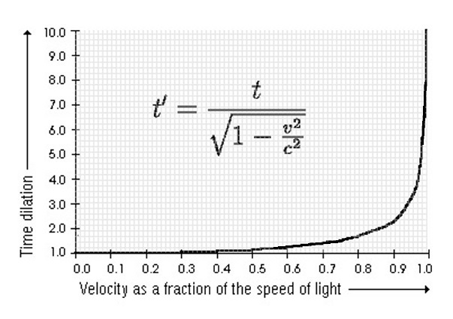
Special Relativity (Einstein again & again 1905)
Einstein's original treatment (1905), it is
based on two postulates:
The laws of physics are invariant (i.e. identical) in all inertial systems (non-accelerating frames of reference).
The speed of light in a vacuum is the same for all observers, regardless of the motion of the light source.
Einstein “On the Electrodynamics of Moving Bodies”.
Resolution of the
inconsistency of Newtonian mechanics with Maxwell's equations of electromagnetism
lack of experimental confirmation for a hypothesized luminiferous aether
Corrects mechanics to handle situations involving motions at a significant fraction of the speed of light
Special relativity is the most accurate (classical) model of motion at any speed when gravitational effects are negligible.

Slide 17
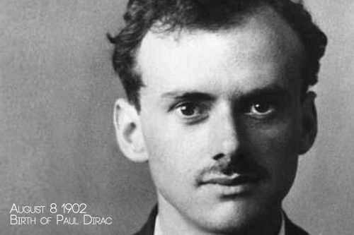
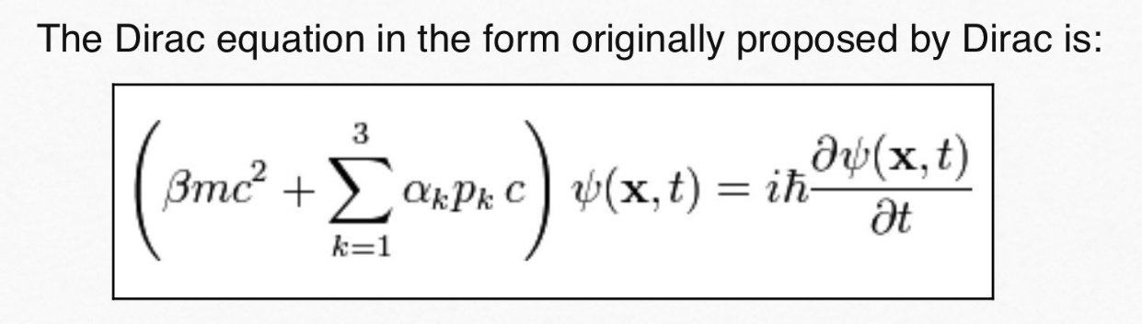
Unification of Quantum Mechanics & Special Relativity
For the discovery of new productive forms of atomic theory
Dirac gave us the “Dirac Equation” (1928), the first and only relativistic generalisation of the Schrödinger equation for spin-1/2
Nobel Prize 1933
2nd youngest person every to win Nobel – age 31
Dirac and his equation also gave us antiparticles
If we accept the view of complete symmetry between positive and negative electric charge so far as concerns the fundamental laws of Nature, we must regard it rather as an accident that the Earth (and presumably the whole solar system), contains a preponderance of negative electrons and positive protons.
It is quite possible that for some of the stars it is the other way about, these stars being built up mainly of positrons and negative protons.
In fact, there may be half the stars of each kind. The two kinds of stars would both show exactly the same spectra, and there would be no way of distinguishing them by present astronomical methods.

Slide 18
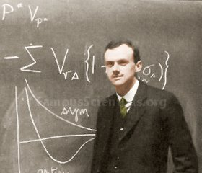
Paul Dirac - man of very few words
A US journalist’s interview with Dirac:
Journalist: “Now Doctor, will you give me in a few words the low-down on all your investigations?”
Dirac: “No.”
Journalist: “Good. Will it be alright if I put it this way – ‘Professor Dirac solves all the problems of mathematical physics, but is unable to find a better way of figuring out baseball’?”
Dirac: “Yes.”
Journalist: “Do you go to the movies?”
Dirac: “Yes.”
Journalist: “When?”
Dirac: “In 1920 – perhaps also in 1930.”

Slide 19
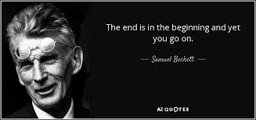
The Problem with Antimatter
Masslessness – the absence of mass – is impossible in nonrelativistic theories. Nonrelativistically, all particles must possess a mass.
Relativistically, masslessness is possible.
Einstein’s Photon is a massless particle
Antimatter = negative-energy matter
… So, for any given system
It costs ZERO energy to create a virtual matter+antimatter pair
or 10 such pairs, or 100 pairs, …
or infinitely many!
Quantum mechanics is an exactly solvable theory when the number of particles is finite
( ∼ 14, with today’s computers and realistic Hamiltonians)
Quantum mechanics is unsolvable when there are infinitely many particles
Relativistic quantum mechanics allows the existence of massless particles and antimatter (negative-energy matter)
– but the existence of either/both destroys relativistic quantum mechanics!

Slide 20
Solving the Problem with Antimatter
There is only one way known to combine quantum mechanics and special relativity
Poincaré-invariant Quantum Field Theory
1st example: Electromagnetism
Quantum electrodynamics (QED), 1946-1950
Feynman, Schwinger, Tomonaga
Nobel Prize (1965):
"for their fundamental work in quantum electrodynamics, with deep-ploughing consequences for the physics of elementary particles".

Slide 21
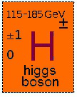
Solving the Problem with Antimatter
There is only one way known to combine quantum mechanics and special relativity
Poincaré-invariant Quantum Field Theory
2nd example: Weak interaction
Radioactive decays, parity-violating decays,
electron-neutrino scattering
Glashow, Salam, Weinberg - 1963-1973
Nobel Prize (1979):
"for their contributions to the theory of the unified weak and electromagnetic interaction between elementary particles, including, inter alia, the prediction of the weak neutral current".
125

Slide 22
Solving the Problem with Antimatter
3rd example:
Strong interaction … all of nuclear physics and anything made from nuclei = basically everything that we can see and/or touch
Existence and composition of the vast bulk of visible matter in the Universe:
proton, neutron
the forces that form them and bind them into nuclei
responsible for more than 98% of the visible matter in the Universe
Politzer, Gross and Wilczek – 1973-1974
Quantum Chromodynamics – QCD
Nobel Prize (2004):
"for the discovery of asymptotic freedom in the theory of the strong interaction".

Slide 23
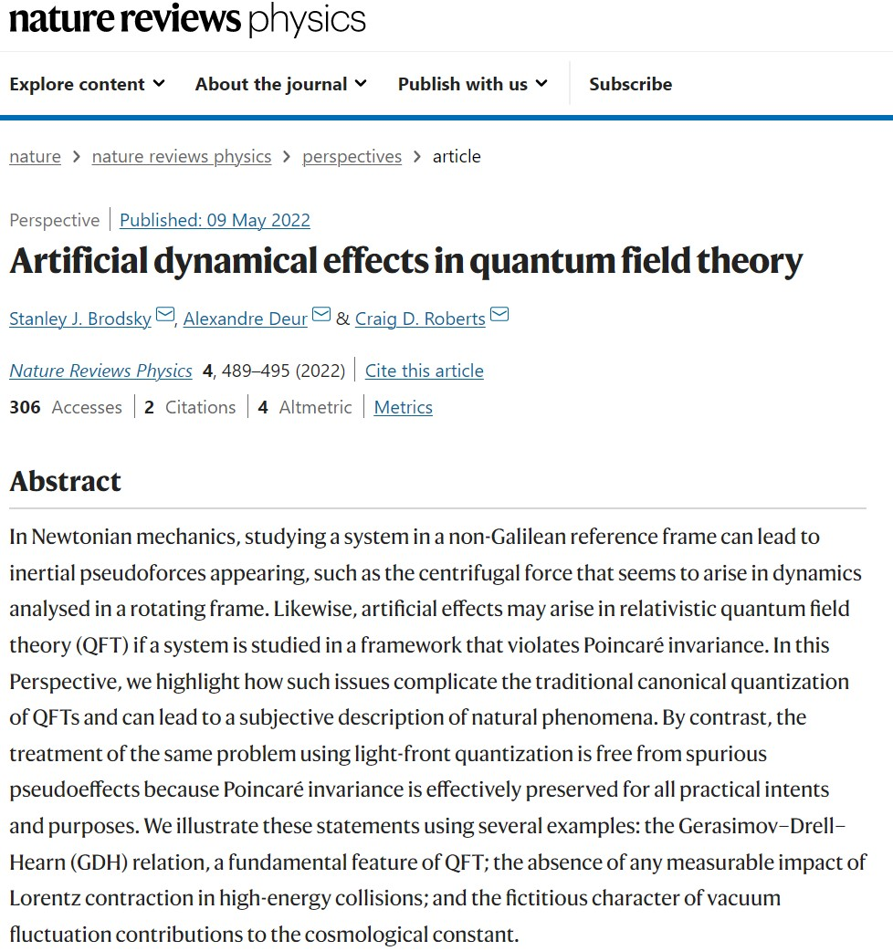
Key to using quantum field theory is Poincaré invariant calculations of observable phenomena
Fundamental scientific principle:
an observer’s choice of conventions cannot affect physical phenomena
Effects that depend on such choices are artificial
not objective features of nature
e.g., physics cannot depend on the choice of units
Most critically
physical effects cannot depend on the observer’s frame
valid phenomena should display Poincaré invariance for relativistic systems.

Slide 24
“Best” Introductions to Quantum Field Theory and QCD
Mattuck, R. D., A guide to Feynman diagrams in the many-body problem (Dover Publications, inc., New York, 1976/1992)
Itzykson, Claude and Zuber, Jean-Bernard, Quantum Field Theory (McGraw-Hill Inc., New York, 1980)
Pascual, P. and Tarrach, R., QCD: Renormalization for the Practitioner, Lecture Notes in Physics 194 (Springer-Verlag, Berlin, 1984)
Roberts, C. D. and Williams, A. G., Dyson-Schwinger equations and their application to hadronic physics, Prog. Part. Nucl. Phys. 33 (1994) pp. 477-575. hep-ph/9403224
Roberts, C. D., Strong QCD and Dyson-Schwinger Equations, IRMA Lect. Math. and Theor. Phys. 21 (2015) pp. 356-458. arXiv:1203.5341

Slide 25
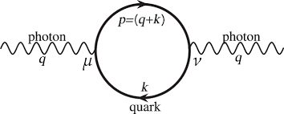
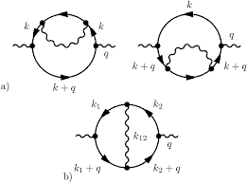
Perturbative Quantum Field Theory
Possibly, you’ve studied quantum field theory (QFT) from perturbative perspective
Feynman diagrams
One loop calculations in QFT are straightforward; but,
almost always, they’re divergent
must be regularised
then renormalisation scheme implemented
Two loop calculations are complicated
and there are many two-loop diagrams
As the number of loops increases,
the number of Feynman diagrams
and the complexity of the calculations grow factorially
Evaluating loop integrals can be extremely challenging,
requiring sophisticated mathematical techniques and numerical methods.
Need to handle multiple loop integrals & their associated tensor structures adds to difficulty

Slide 26
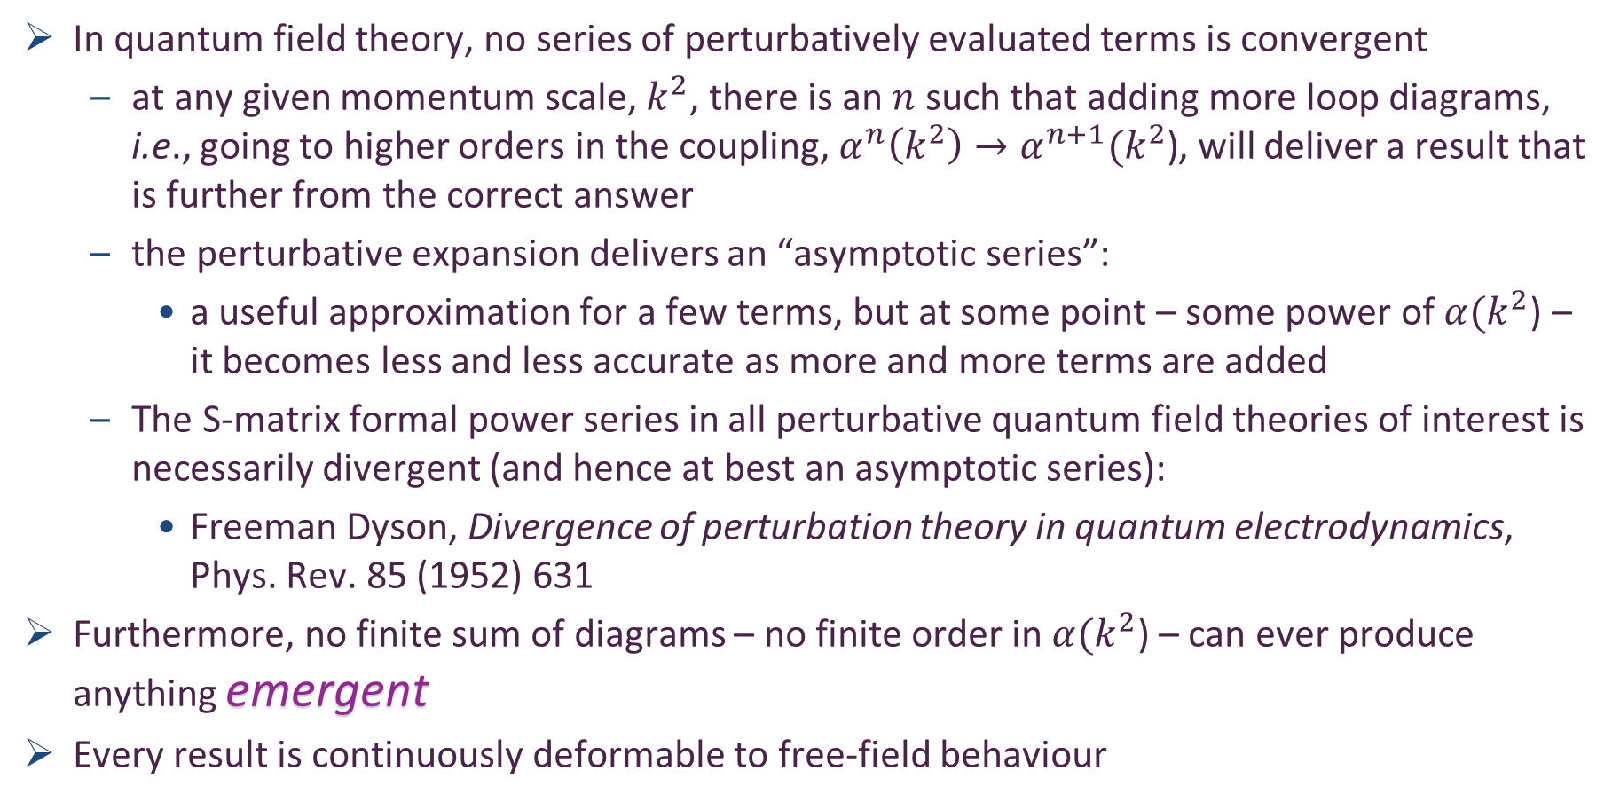
Perturbative Quantum Field Theory
In quantum field theory, no series of perturbatively evaluated terms is convergent
at any given momentum scale, $k^{2}$, there is an $n$ such that adding more loop diagrams, i.e., going to higher orders in the coupling, $α^{n}\left(k^{2}\right)→α^{n+1}(k^{2}\text{)}$, will deliver a result that is further from the correct answer
the perturbative expansion delivers an “asymptotic series”:
a useful approximation for a few terms, but at some point – some power of $α(k^{2}$) – it becomes less and less accurate as more and more terms are added
The S-matrix formal power series in all perturbative quantum field theories of interest is necessarily divergent (and hence at best an asymptotic series):
Freeman Dyson, Divergence of perturbation theory in quantum electrodynamics, Phys. Rev. 85 (1952) 631
Furthermore, no finite sum of diagrams – no finite order in $α(k^{2}$) – can ever produce anything emergent
Every result is continuously deformable to free-field behaviour

Slide 27
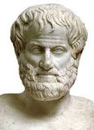
Emergentism
One might define emergent phenomena as those features of Nature which don’t readily admit explanation solely in terms of known or conjectured rules.
The concept is at least as old as Aristotle (384-322 BC), who argued that a compound item can have (emergent) properties in the whole which are not explicable merely through the independent actions of the item’s constituent parts.
His view is often represented by the statement:
“The whole is more than the sum of its parts”.
In this sense, emergence has its origins in the Greek “sunergos”: “together” plus “working” = origin of our concept of synergy (协同效应), viz. things working together more effectively than could be anticipated from their independent actions in isolation.
This perspective is typically contrasted with that described as reductionism; namely, the view that everything in Nature can ultimately be viewed as no more complex in principle than,
e.g. a (very good) watch, which is clearly a complex object; but, equally clearly, not more than the sum of its parts.

Slide 28
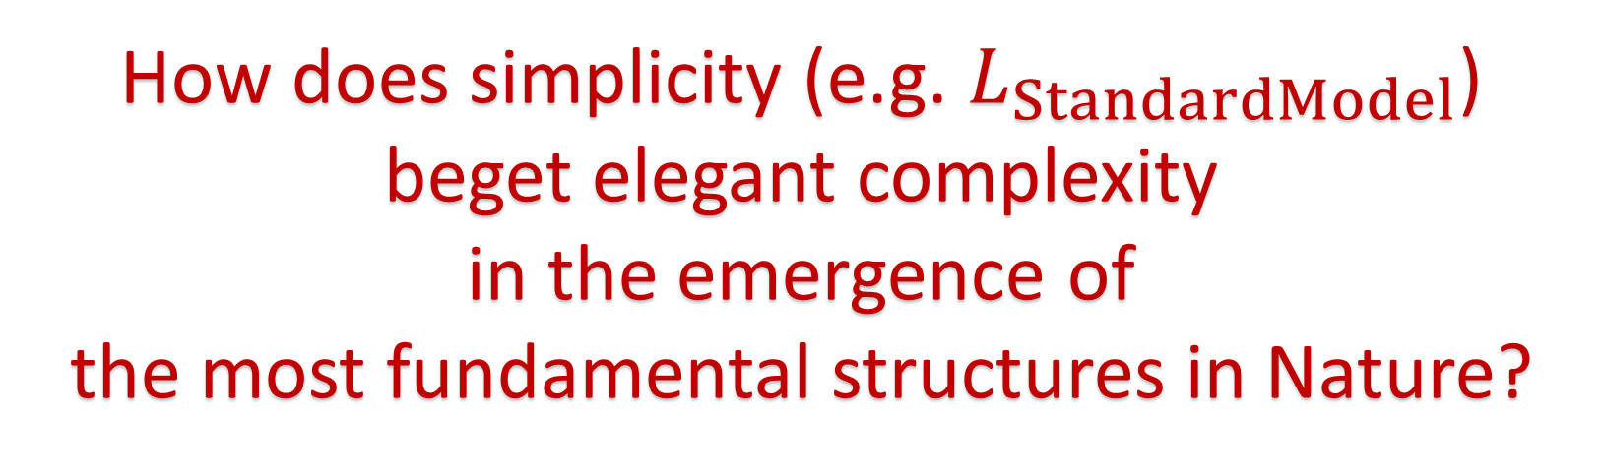
Emergentism
One might define emergent phenomena as those features of Nature which don’t readily admit explanation solely in terms of known or conjectured rules.
The concept is at least as old as Aristotle (384-322 BC), who argued that a compound item can have (emergent) properties in the whole which are not explicable merely through the independent actions of the item’s constituent parts.
His view is often represented by the statement:
“The whole is more than the sum of its parts”.
In this sense, emergence has its origins in the Greek “sunergos”: “together” plus “working” = origin of our concept of synergy (协同效应), viz. things working together more effectively than could be anticipated from their independent actions in isolation.
This perspective is typically contrasted with that described as reductionism; namely, the view that everything in Nature can ultimately be viewed as no more complex in principle than,
e.g. a (very good) watch, which is clearly a complex object; but, equally clearly, not more than the sum of its parts.
How does simplicity (e.g. $L_{StandardModel}$)
beget elegant complexity
in the emergence of
the most fundamental structures in Nature?

Slide 29
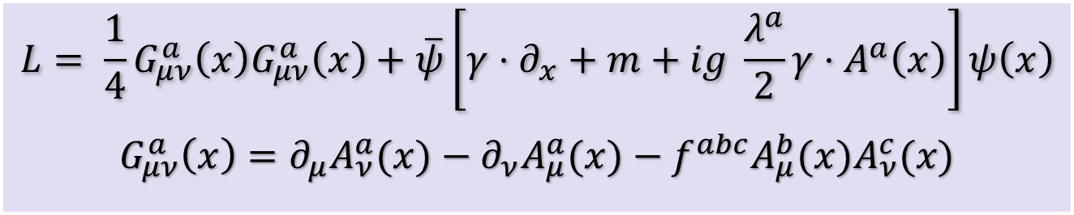
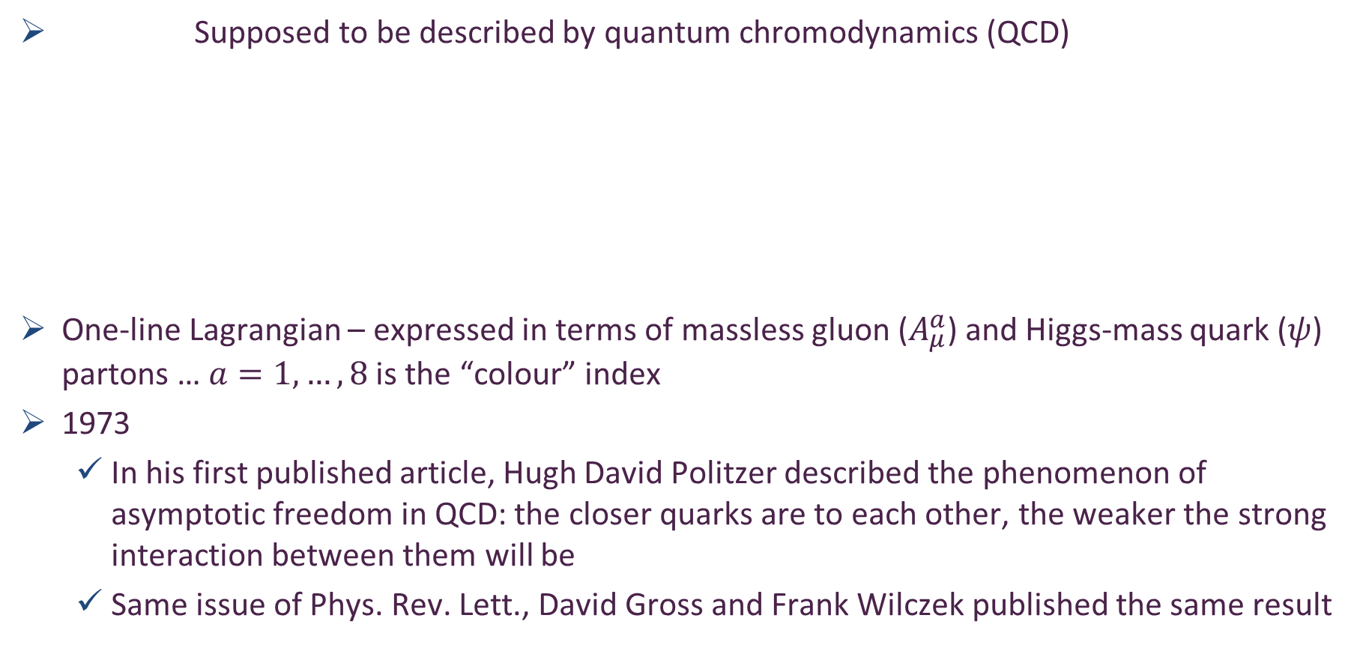
Strong Interactions in the Standard Model
quark current mass
generated by
Higgs boson
couplings into QCD
Supposed to be described by quantum chromodynamics (QCD)
One-line Lagrangian – expressed in terms of massless gluon ($A_{μ}^{a}$) and Higgs-mass quark ($ψ$) partons … $a=1, …, 8$ is the “colour” index
1973
In his first published article, Hugh David Politzer described the phenomenon of asymptotic freedom in QCD: the closer quarks are to each other, the weaker the strong interaction between them will be
Same issue of Phys. Rev. Lett., David Gross and Frank Wilczek published the same result
2004
$$L= \frac{1}{4}G_{μν}^{a}\left(x\right)G_{μν}^{a}\left(x\right)+\overline{ψ}\left[γ⋅∂_{x}+m+ig \frac{λ^{a}}{2}γ⋅A^{a}\left(x\right)\right]ψ\left(x\right)$$
$$G_{μν}^{a}\left(x\right)=∂_{μ}A_{ν}^{a}(x)−∂_{ν}A_{μ}^{a}(x)−f^{abc}A_{μ}^{b}{(x)A}_{ν}^{c}(x)$$
No mass term
for gluons
H. Fritzsch, M. Gell-Mann, Proceedings of the XVI International Conference
on High Energy Physics, Chicago, 1972, Vol. l, 135.

Slide 30
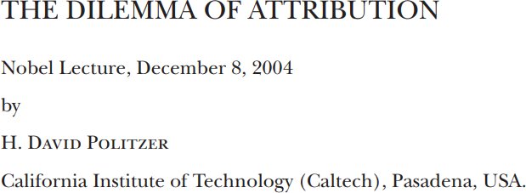

Strong Interactions in the Standard Model
The establishment by the mid-1970’s of QCD as the correct theory of the strong interactions completed what is now known prosaically as the Standard Model.
It offers a description of all known fundamental physics except for gravity, and gravity is something that has no discernible effect when particles are studied a few at a time.
However, the situation is a bit like the way that the Navier-Stokes equation accounts for the flow of water. The equations are at some level obviously correct, but there are only a few, limited circumstances in which their consequences can be worked out in any detail.
Nevertheless, many leading physicists were inclined to conclude in the late 1970’s that the task of basic physics was nearly complete, and we’d soon be out of jobs.
A famous example was the inaugural lecture of Stephen Hawking as Lucasian Professor of Mathematics, a chair first held by Isaac Barrow at Cambridge University. Hawking titled his lecture, “Is the End in Sight for Theoretical Physics?” And he argued strongly for “Yes”.

Slide 31
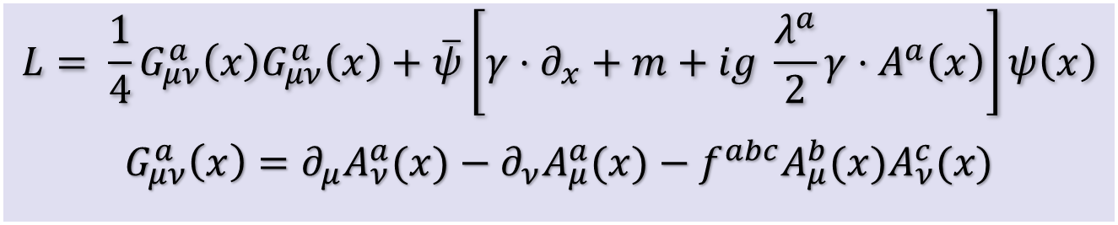

Quantum Chromodynamics
$$L= \frac{1}{4}G_{μν}^{a}\left(x\right)G_{μν}^{a}\left(x\right)+\overline{ψ}\left[γ⋅∂_{x}+m+ig \frac{λ^{a}}{2}γ⋅A^{a}\left(x\right)\right]ψ\left(x\right)$$
$$G_{μν}^{a}\left(x\right)=∂_{μ}A_{ν}^{a}(x)−∂_{ν}A_{μ}^{a}(x)−f^{abc}A_{μ}^{b}{(x)A}_{ν}^{c}(x)$$
H. Fritzsch, M. Gell-Mann, Proceedings of the XVI International Conference on High Energy Physics, Chicago, 1972, Vol. l, 135
One-line Lagrangian – expressed in terms of
massless gluon ($A_{μ}^{a}$) and Higgs-mass quark ($ψ$) partons
Which are NOT the degrees-of-freedom measured in detectors
Gluon and Quark Confinement
Essentially non-perturbative
Advantages of the Color Octet Gluon Picture, H. Fritzsch, M. Gell-Mann, H. Leutwyler, Phys. Lett. B 47 (1973) 365-368
“The quarks come in three "colors," but all physical states and interactions are supposed to be singlets with respect to the SU(3) of color. Thus, we do not accept theories in which quarks are real, observable particles; nor do we allow any scheme in which the color non-singlet degrees of freedom can be excited.”
Emergence now becomes important: Lagrangian degrees-of-freedom are unobservable

Slide 32
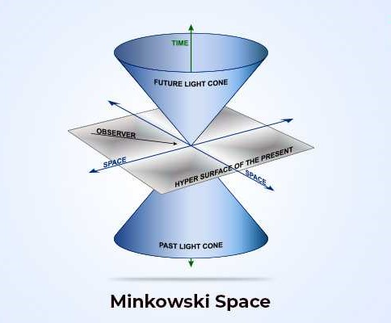
Space and Time = Spacetime

Slide 33
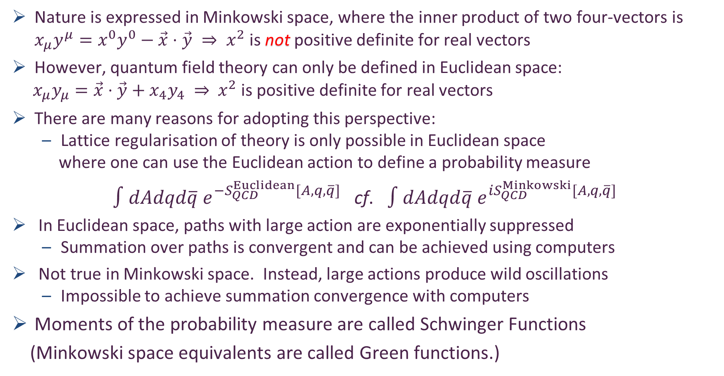
Nature’s Natural Space
Nature is expressed in Minkowski space, where the inner product of two four-vectors is $x_{μ}y^{μ}=x^{0}y^{0}−\vec{x}⋅\vec{y} ⇒ x^{2}$ is not positive definite for real vectors
However, quantum field theory can only be defined in Euclidean space:
$x_{μ}y_{μ}=\vec{x}⋅\vec{y}+x_{4}y_{4} ⇒{ x}^{2}$ is positive definite for real vectors
There are many reasons for adopting this perspective:
Lattice regularisation of theory is only possible in Euclidean space
where one can use the Euclidean action to define a probability measure
$∫dAdqd\overline{q} e^{−S_{QCD}^{Euclidean}[A,q,\overline{q}]}$ cf. $∫dAdqd\overline{q} e^{iS_{QCD}^{Minkowski}[A,q,\overline{q}]}$
In Euclidean space, paths with large action are exponentially suppressed
Summation over paths is convergent and can be achieved using computers
Not true in Minkowski space. Instead, large actions produce wild oscillations
Impossible to achieve summation convergence with computers
Moments of the probability measure are called Schwinger Functions
(Minkowski space equivalents are called Green functions.)

Slide 34
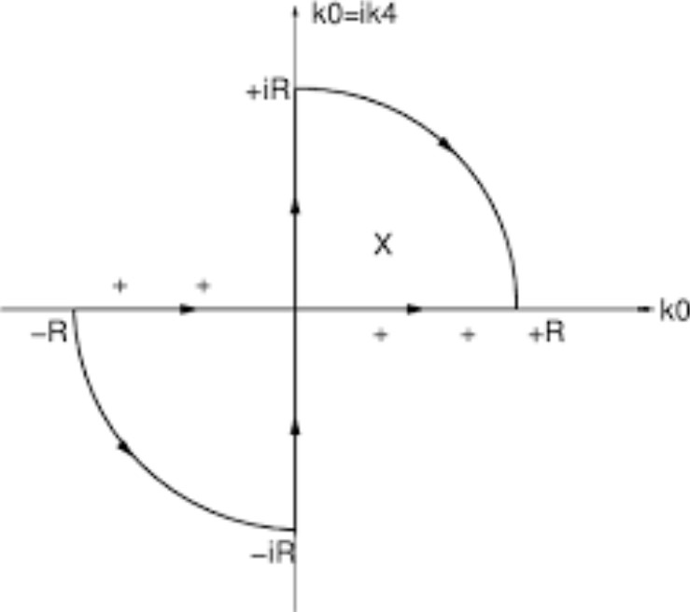
Nature’s Natural Space
Choice must be made because any “Wick rotation” between Minkowski space and Euclidean space is a purely formal exercise
validity is only guaranteed for perturbative calculations
If QCD really does (somehow) explain emergence of hadron mass and structure, then …
nonlinear, nonperturbative dynamics (emergent phenomena) must be crucial
Consequently …
when calculating & summing the necessarily infinite collection of processes associated with a given experimental observable
one cannot assume that any of the requirements necessary to mathematically justify a Wick rotation are satisfied
Nonanalyticities in these quadrants will break simple form correspondence between Minkowski and Euclidean space equations
May completely destroy all correspondences

Slide 35
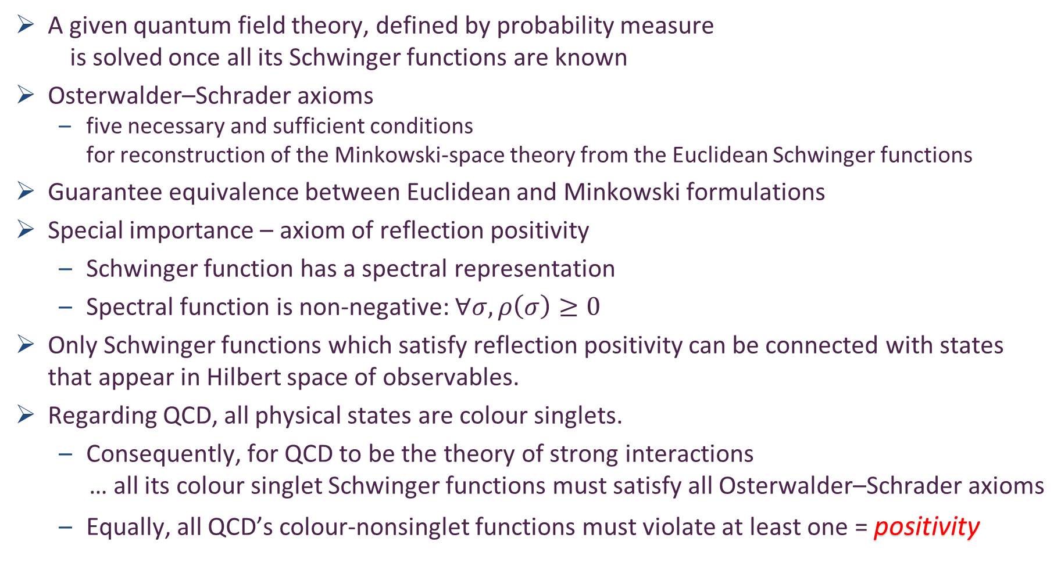

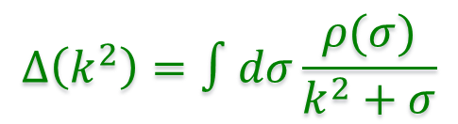
Nature’s Natural Space: Euclidean $↔$Minkowski
A given quantum field theory, defined by probability measure
is solved once all its Schwinger functions are known
Osterwalder–Schrader axioms
five necessary and sufficient conditions
for reconstruction of the Minkowski-space theory from the Euclidean Schwinger functions
Guarantee equivalence between Euclidean and Minkowski formulations
Special importance – axiom of reflection positivity
Schwinger function has a spectral representation
Spectral function is non-negative: $∀σ, ρ\left(σ\right)≥0$
Only Schwinger functions which satisfy reflection positivity can be connected with states that appear in Hilbert space of observables.
Regarding QCD, all physical states are colour singlets.
Consequently, for QCD to be the theory of strong interactions
… all its colour singlet Schwinger functions must satisfy all Osterwalder–Schrader axioms
Equally, all QCD’s colour-nonsinglet functions must violate at least one = positivity
$$Δ\left(k^{2}\right)=∫dσ\frac{ρ(σ)}{k^{2}+σ}$$

Slide 36
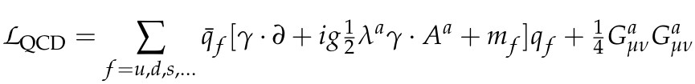
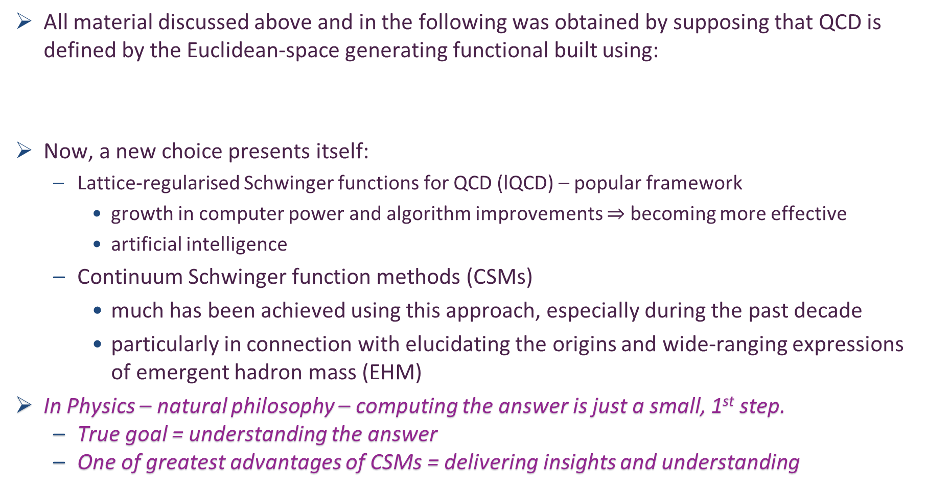
Schwinger Functions Methods
All material discussed above and in the following was obtained by supposing that QCD is defined by the Euclidean-space generating functional built using:
Now, a new choice presents itself:
Lattice-regularised Schwinger functions for QCD (lQCD) – popular framework
growth in computer power and algorithm improvements $⇒$ becoming more effective
artificial intelligence
Continuum Schwinger function methods (CSMs)
much has been achieved using this approach, especially during the past decade
particularly in connection with elucidating the origins and wide-ranging expressions of emergent hadron mass (EHM)
In Physics – natural philosophy – computing the answer is just a small, 1st step.
True goal = understanding the answer
One of greatest advantages of CSMs = delivering insights and understanding
Organic
Intelligence
= Thinking

Slide 37
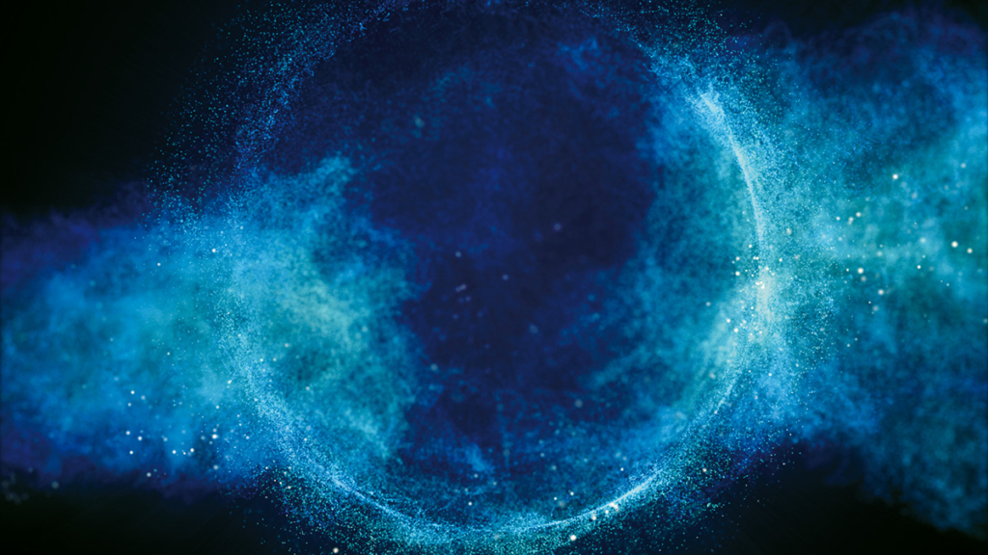
Origin of Mass

Slide 38
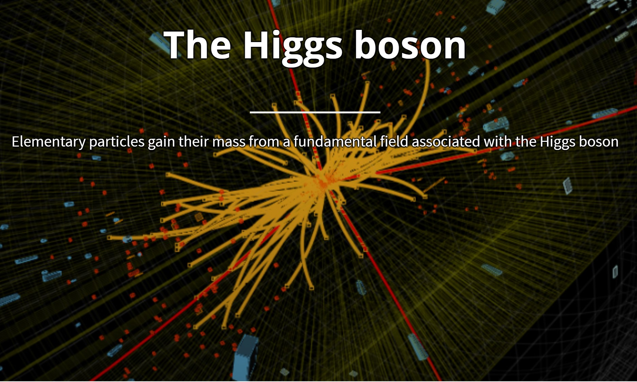
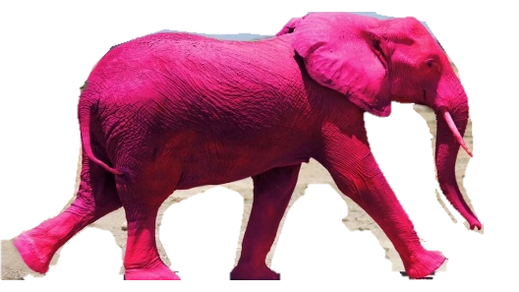
Or so the story has gone

Slide 39
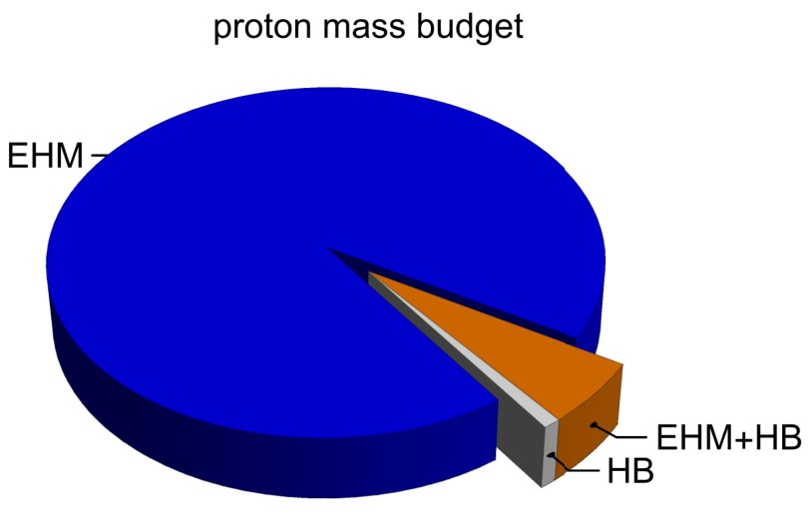
Emergence of Hadron Mass
Standard Model of Particle Physics has one obvious mass-generating mechanism
= Higgs Boson … impacts are critical to evolution of Universe as we know it
However, Higgs boson alone is responsible for just ∼ 1% of the visible mass in the Universe
Proton mass budget … only 9 MeV/939 MeV is directly from Higgs
Decomposition is
gauge invariant
Poincaré invariant
scale invariant
Evidently, Nature has another very effective mechanism for producing mass:
Emergent Hadron Mass (EHM)
Alone, it produces 94% of the proton’s mass
Remaining 5% is generated by constructive interference between EHM and Higgs-boson
What is the origin of EHM?

Slide 40
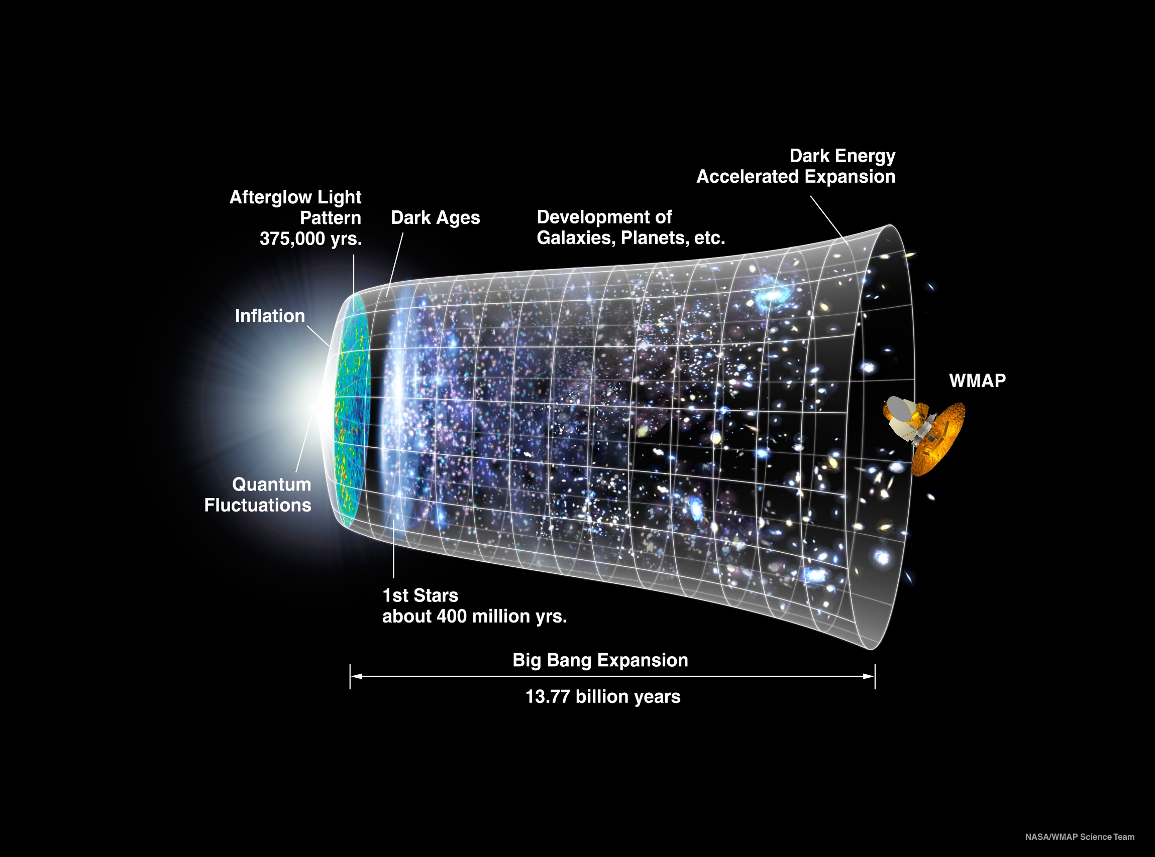
Our Universe
Nuclear-scale mass emerged 0.000001 seconds after the Big Bang
Its appearance was crucial to the formation of the Universe as we know it

Slide 41
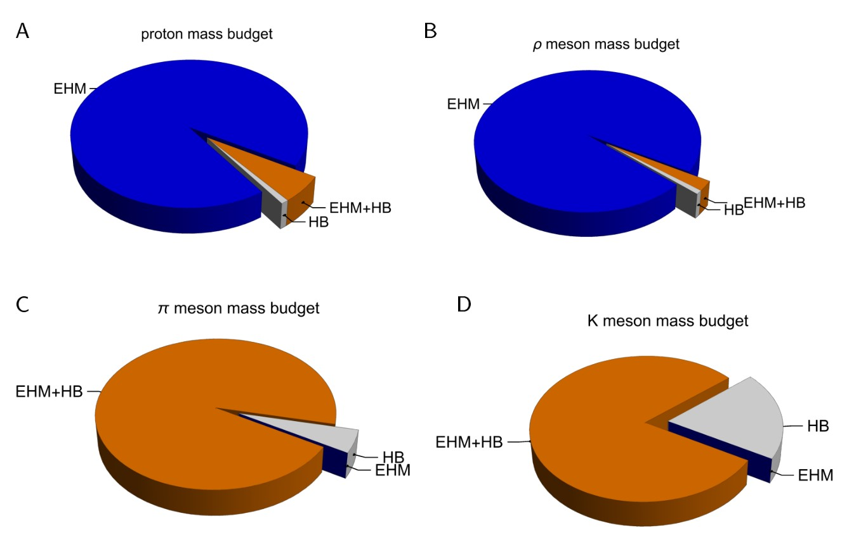

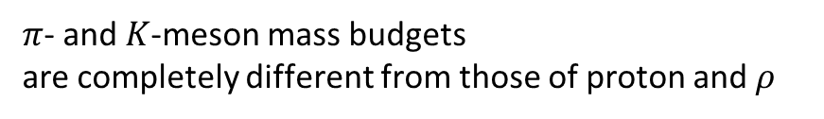
Emergence of Hadron Mass - Basic Questions
Decompositions are
gauge invariant
Poincaré invariant
scale invariant
What is the origin of EHM?
Does it lie within QCD?
What are EHM’s connections with …
Gluon and quark confinement?
Dynamical chiral symmetry breaking (DCSB) – quarks massive, yet pion massless?
Nambu-Goldstone modes = π & K?
What is the role of Higgs in modulating EHM expressions in observable properties of hadrons?
Without Higgs mechanism of mass generation, π and K would be indistinguishable
What and wherefrom is mass?
Proton and $ρ$-meson mass budgets are practically identical
$$↑↓ →↑↑$$
$π$- and $K$-meson mass budgets
are completely different from those of proton and $ρ$

Slide 42

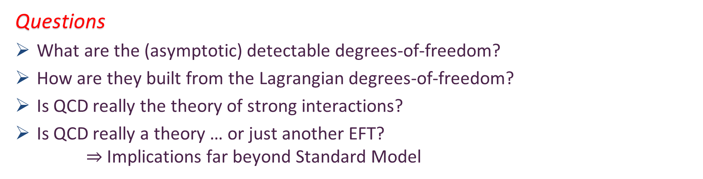
Quantum Chromodynamics
$$L= \frac{1}{4}G_{μν}^{a}\left(x\right)G_{μν}^{a}\left(x\right)+\overline{ψ}\left[γ⋅∂_{x}+m+ig \frac{λ^{a}}{2}γ⋅A^{a}\left(x\right)\right]ψ\left(x\right)$$
$$G_{μν}^{a}\left(x\right)=∂_{μ}A_{ν}^{a}(x)−∂_{ν}A_{μ}^{a}(x)−f^{abc}A_{μ}^{b}{(x)A}_{ν}^{c}(x)$$
One-line Lagrangian – expressed in terms of
massless gluon ($A_{μ}^{a}$) and Higgs-mass quark ($ψ$) partons
Which are NOT the degrees-of-freedom measured in detectors
Gluon and Quark Confinement
Questions
What are the (asymptotic) detectable degrees-of-freedom?
How are they built from the Lagrangian degrees-of-freedom?
Is QCD really the theory of strong interactions?
Is QCD really a theory … or just another EFT?
$⇒$ Implications far beyond Standard Model
Hadrons
= protons, pions, etc.

Slide 43
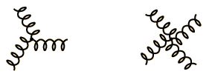
Quantum Chromodynamics
$$L= \frac{1}{4}G_{μν}^{a}\left(x\right)G_{μν}^{a}\left(x\right)+\overline{ψ}\left[γ⋅∂_{x}+m+ig \frac{λ^{a}}{2}γ⋅A^{a}\left(x\right)\right]ψ\left(x\right)$$
$$G_{μν}^{a}\left(x\right)=∂_{μ}A_{ν}^{a}(x)−∂_{ν}A_{μ}^{a}(x)−f^{abc}A_{μ}^{b}{(x)A}_{ν}^{c}(x)$$
This term is the only thing that makes QCD different from quantum electrodynamics (QED)
It means that gluons interact with each other at leading order in perturbation theory
3-gluon vertex
4-gluon vertex

Slide 44

Running couplings and masses
Quantum gauge-field theories are all typified by the feature that Nothing is Constant
Distribution of charge and mass, number of particles, etc., indeed, all the things that quantum mechanics holds fixed, depend upon wavelength of tool used to measure them
particle number is not conserved in quantum field theory … energy can create particles
Couplings and masses are renormalised via processes involving virtual-particles. Such effects make these quantities depend on the energy scale at which one observes them

Slide 45



QED cf. QCD?
2004 Nobel Prize in Physics : Politzer, Gross and Wilczek
QED running coupling (textbook)
QCD running coupling (textbook)
500%
5 x10⁻⁵=0.7%
Add 3-gluon self-interaction
gluon
antiscreening
fermion
screening

Slide 46

Millenium Madness
In 1900, the German mathematician David Hilbert opened his landmark address to the International Congress of Mathematicians in Paris, laying out 23 of the great unsolved problems of the day. “For the close of a great epoch,” Hilbert declared, “not only invites us to look back into the past but also directs our thoughts to the unknown future.”
In May 2000, the Clay Mathematics Institute of Cambridge, Mass., emulated Hilbert, announcing (in Paris, for full effect) seven “Millennium Prize Problems,” each with a bounty of $1 million.
In July 2000, a conference on superstring theory at the University of Michigan ended with a session called “Millennium Madness,” choosing 10 of the most perplexing problems in their field

Slide 47

Excerpt from the top-10
Can we quantitatively understand quark and gluon confinement in quantum chromodynamics and the existence of a mass gap?
Quantum chromodynamics is the theory describing the strong nuclear force. Carried by gluons, it binds quarks into particles like protons and neutrons. Apparently, the tiny subparticles are permanently confined: one can't pull a quark or a gluon from a proton because the strong force gets stronger with distance and snaps them right back inside.

Slide 48


Confinement?
Millennium prize of $1,000,000 for proving that SU_{c}(3) gauge theory is mathematically well-defined, which will necessarily prove or disprove a confinement conjecture

Slide 49

Confinement?

Slide 50

Basic Questions in Nature …

Slide 51

Basic Questions in Nature … that insightful physics might answer in foreseeable future
What is the origin of the nuclear-physics mass scale
$m_{p}=$ proton mass$≈1$GeV
that characterises all visible matter?
Whatever it is, why is the pion seemingly oblivious: $m_{π}≈\frac{1}{7}m_{p}$?
How is this phenomenon expressed in measurable quantities?
The expressions are (almost) certainly system specific!
Answers should be frame and scale invariant

Slide 52


QCD’s scale anomaly
Prima Facie, the QCD Lagrangian
CANNOT support a nonzero value of this expectation value.

Slide 53

Strong Interactions in the Standard Model
Only apparent scale in chromodynamics is mass of the quark field
Quark mass is generated by Higgs boson couplings into QCD
In connection with everyday matter, that mass is less-then 0.5% of the empirical scale for strong interactions,
viz. more-than two orders-of-magnitude smaller
Plainly, the Higgs-generated mass is very far removed from the natural scale for strongly-interacting matter
Nuclear physics mass-scale – 1 GeV – is an emergent feature of the Standard Model
No amount of staring at L_{QCD} can reveal that scale
Contrast with quantum electrodynamics, e.g. spectrum of hydrogen levels measured in units of m_{e}, which appears in L_{QED}

Slide 54
Whence Mass?
Classical chromodynamics … non-Abelian local gauge theory
Remove the current mass … there’s no energy scale left
No dynamics in a scale-invariant theory; only kinematics … the theory looks the same at all length-scales … there can be no clumps of anything … hence bound-states are impossible.
Our Universe can’t exist
Higgs boson doesn’t solve this problem …
normal matter is constituted from light-quarks
the mass of protons and neutrons, the kernels of all visible matter, are 100-times larger than anything the Higgs can produce
Where did it all begin? … becomes … Where did it all come from?

Slide 55


Slide 56


Trace Anomaly
Dilations = compression or expansion of length (mass) scales
Scale invariant theory = dilations don’t change anything
Current conservation:
Divergence of dilation current vanishes in a scale invariant theory
In a scale invariant theory
the energy-momentum tensor must be traceless: $∂_{μ}D_{μ}=$T_{μμ} ≡ 0
Regularisation and renormalisation of (ultraviolet) divergences in Quantum Chromodynamics introduces a mass-scale
… dimensional transmutation:
Lagrangian’s constants (couplings and masses) become dependent on a mass-scale, ζ
α → α(ζ) in QCD’s (massless) Lagrangian density, L(m=0)
⇒ ∂_{μ}D_{μ} = δL/δσ = αβ(α) dL/dα = β(α) ¼G_{μν} G_{μν} = T_{ρρ} =: Θ₀
Quantisation of renormalisable four-dimensional theory forces nonzero value for trace of energy-momentum tensor
Trace anomaly
QCD β function … specifies how the coupling “runs”

Slide 57

Trace Anomaly
Knowing that a trace anomaly exists does not deliver a great deal
… Indicates only that a mass-scale must exist
Key Question: Can one compute and/or understand the magnitude of that scale?
One can certainly measure the magnitude … consider proton:
In the chiral limit the entirety of the proton’s mass is produced by the trace anomaly, Θ₀
… In perturbative QCD, Θ₀ measures the strength of gluon self-interactions
… so, from one perspective,
m_{p} is (somehow) completely generated by glue.
The mass of visible matter is almost entirely produced by massless non-matter fields

Slide 58

On the other hand …

Slide 59
Trace Anomaly
In the chiral limit, pion is massless Nambu-Goldstone boson:
⇒
Does this mean that the scale anomaly vanishes trivially in the pion state, i.e. gluons contribute nothing to the pion mass?
Difficult way to obtain “zero”!
Easier to imagine that “zero” owes to cancellations between different operator contributions to the expectation value of Θ₀.
Of course, such precise cancellation should not be an accident.
It could only arise naturally because
of some symmetry and/or symmetry-breaking pattern.
“Nothing can come of nothing.”
William Shakespeare, "King Lear"

Slide 60
Whence “1” and yet “0” ?
No statement of the question
“How does the mass of the proton arise?”
is complete without the additional clause
“How does the pion remain massless?”
Natural visible-matter mass-scale must emerge simultaneously with apparent preservation of scale invariance in related systems
Expectation value of Θ₀ in pion is always zero,
irrespective of the size of the natural mass-scale for strong interactions = m_{p}

Slide 61
Whence “1” and yet “0” ?
No statement of the question
“How does the mass of the proton arise?”
is complete without the additional clause
“How does the pion remain massless?”
Natural visible-matter mass-scale must emerge simultaneously with apparent preservation of scale invariance in related systems
Expectation value of Θ₀ in pion is always zero,
irrespective of the size of the natural mass-scale for strong interactions = m_{p}
Modern Physics must
Elucidate the entire array of Empirical Consequences
of the Mechanism responsible
so that the Standard Model can be Tested and Bounded

Slide 62


In the Beginning…

Slide 63


Google is not infallible

Slide 64


Gluon gap (Dyson) equation
Known behaviour of QCD running coupling
$⇒$ long wavelength (low energy+momentum) gluons are strongly interacting
Potentially huge nonperturbative feedback effects

Slide 65




Ancient History
Cornwall’s estimate: $m_{g}=0.5\left(2\right)GeV≈\frac{1}{2}m_{p}$
$≈$ 45 years ago
Dynamical mass generation in continuum quantum chromodynamics,
J.M. Cornwall, Phys. Rev. D 26 (1981) 1453 … $>1100$ citations
Owing to strong self-interactions, gluon partons $⇒$ gluon quasiparticles,
described by a mass function that is large at infrared momenta
3-gluon vertex
4-gluon vertex
$$\frac{1}{m_{g}^{2}}$$
Truly mass from nothing
An interacting theory, written in terms of massless gluon fields, produces dressed gluon fields that are characterised by a mass function that is large at infrared momenta
Gluon propagator … continuum and lattice QCD agree
QCD fact
Continuum theory and lattice simulations agree
Empirical verification?

Slide 66



Ancient History
D. Binosi, Emergent Hadron Mass in Strong Dynamics, Few Body Syst. 63 (2022) 42.
M. N. Ferreira, J. Papavassiliou, Gauge Sector Dynamics in QCD, Particles 6 (1) (2023) 312–363.
Today’s best estimate: $m_{g}^{RGI}=0.43\left(1\right)GeV$
Gauge Invariance and Mass,
J. S. Schwinger
Phys. Rev. 125 (1962) 397-398
It is argued that the gauge invariance of a vector field does not necessarily imply zero mass for an associated particle if the current vector coupling is sufficiently strong.
EHM means
Gluons are massive via Schwinger Mechanism
More than 40 years ago
Dynamical mass generation in continuum quantum chromodynamics,
J.M. Cornwall, Phys. Rev. D 26 (1981) 1453 … $∼1050$ citations
Owing to strong self-interactions, gluon partons $⇒$ gluon quasiparticles,
described by a mass function that is large at infrared momenta
3-gluon vertex
4-gluon vertex
$$\frac{1}{m_{g}^{2}}$$
Truly mass from nothing
An interacting theory, written in terms of massless gluon fields, produces dressed gluon fields that are characterised by a mass function that is large at infrared momenta
Gluon propagator … continuum and lattice QCD agree
QCD fact
Continuum theory and lattice simulations agree
Empirical verification?

Slide 67



QED Running Coupling $–$ Gell-Mann $–$ Low effective charge
To define QED, one introduces three renormalisation constants:
$Z_{1}$… fermion-photon vertex & $Z_{2}$ … fermion wave function
& $Z_{3}$ … photon wave function
Ward identity:
$Z_{1}=Z_{2}$ … basically, this is necessary and sufficient
to ensure current conservation
Only one renormalisation constant remains
$Z_{3}$ … photon wave function; hence, photon propagator
So, running of coupling in QED is completely determined by renormalisation-induced flow (momentum dependence) of the photon propagator
$α_{QED}\left(q^{2}\right)$ … most familiar & best-known running coupling
precision better than $1/{10}^{9}$
Textbook material
1292 citations

Slide 68


QED Running Coupling $–$ Gell-Mann $–$ Low effective charge
To define QED, one introduces three renormalisation constants:
$Z_{1}$… fermion-photon vertex & $Z_{2}$ … fermion wave function
& $Z_{3}$ … photon wave function
Ward identity:
$Z_{1}=Z_{2}$ … basically, this is necessary and sufficient
to ensure current conservation
Only one renormalisation constant remains
$Z_{3}$ … photon wave function; hence, photon propagator
So, running of coupling in QED is completely determined by renormalisation-induced flow (momentum dependence) of the photon propagator
$α_{QED}\left(q^{2}\right)$ … most familiar & best-known running coupling
precision better than $1/{10}^{9}$

Slide 69

QCD Running Coupling
QCD has 8 coupling renormalisation constants
Slavnov-Taylor (generalised Ward) identities relate the various constants
ensure uniqueness of coupling and “gauge invariance” in perturbation theory
However, with so many choices of couplings & vertices & propagators, then using standard formulation of QCD equations of motion:
Running coupling cannot be defined via gluon vacuum polarisation
No unique definition of running coupling
Actually, uncountable infinity of distinct nonperturbative definitions

Slide 70



Slide 71




Process independent effective charge = running coupling
W orkshop on Dyson-Schwinger Equations in Modern Mathematics
and Physics (DSEMP2014) Trento, Italy, September 22-26, 2014
Effective charge from lattice QCD, Zhu-Fang Cui, Jin-Li Zhang et al.,
NJU-INP 014/19, arXiv:1912.08232 [hep-ph], Chin. Phys. C 44 (2020) 083102/1-10
$2649$ total downloads
Modern theory – exploiting pinch technique and background field method – enables unique QCD analogue of
“Gell-Mann – Low”
running charge to be
rigorously defined and calculated
Analysis of QCD’s gauge sector
yields a parameter-free prediction
N.B. Qualitative change in α̂_{PI}(k) at k ≈ ½ m_{p}
No Landau Pole
Below $k∼{{\hat{m}}_{0}}_{ },$interactions become scale independent, just as they were in the Lagrangian; so, QCD becomes practically conformal again
Process independent strong running coupling
Daniele Binosi et al., arXiv:1612.04835 [nucl-th], Phys. Rev. D 96 (2017) 054026/1-7
Experimental determination of the QCD effective charge α_{g1}(Q).
A. Deur; V. Burkert; J.-P. Chen; W. Korsch, Particles 5 (2022) 171
QCD Running Couplings and Effective Charges, Alexandre Deur, Stanley J. Brodsky and Craig Roberts, e-Print: 2303.00723 [hep-ph], Prog. Part. Nucl. Phys. 134 (2024) 104081

Slide 72





Process-independent Effective Charge
https://1drv.ms/b/s%21Apbnb6VLY1RplPRdL0J4Wm-tlzQd-Q?e=hdZxHH
May 2024
Most-read article in the May issue of SciAm
Translated into Chinese, French, German, Italian
Cover story on Chinese and German editions
SciAm is one of the Top-5 popular science magazines in the world.
International circulation that exceeds 10,000,000 readers per month in subscriptions and millions more via social media etc.

Slide 73

Dynamical Chiral Symmetry Breaking
Craig D Roberts
John D Roberts

Slide 74


Quark Gap (Dyson) Equation

Slide 75

Where does the mass come from?
Deceptively simply picture
Corresponds to the sum of a countable infinity of diagrams.
NB. QED has 12,672 α⁵ diagrams
Impossible to compute this in perturbation theory.
The standard algebraic manipulation
tools are just inadequate
α_{S}²³
Just one of the terms that are summed in a solution of the simplest, reasonable truncation of QCD’s
gap equation
Notes:
QED 12,672 alpha^5 diagrams

Slide 76



DCSB à la Nambu
Mathematical form of the gap equation
Contact-interaction gap equation

Slide 77



DCSB à la Nambu
Multiply the gap equation by (-iγ∙p); trace over Dirac indices:
Angular integral vanishes, therefore A(p²) = 1.
This owes to the fact that the model is defined by a four-fermion contact-interaction in configuration space, which entails a momentum-independent interaction in momentum space.
Simply take Dirac trace of model’s gap equation:
Integrand is p²-independent, therefore the only solution is
B(p²) = constant = M.
General form of the propagator for a fermion dressed by the contact interaction:
$S(p) = 1/[ i γ∙p + M ]$

Slide 78


Contact interaction & a mass gap?
Critical coupling for dynamical mass generation?
Evaluate the integrals
Λ defines the model’s mass-scale. Henceforth set Λ = 1, then all other dimensioned quantities are given in units of this scale, in which case the gap equation can be written
Chiral limit, m=0
Solutions?
One is obvious; viz., M=0
This is the perturbative result
… start with no mass, end up with no mass
Chiral limit, m=0
Suppose, on the other hand that M≠0, and thus may be cancelled
This nontrivial solution can exist if-and-only-if one may satisfy
3π² m_{G}² = C(M²,1)

Slide 79
Contact interaction & a mass gap?
Critical coupling for dynamical mass generation!
Can one satisfy 3π² m_{G}² = C(M²,1) ?
C(M², 1) = 1 − M² ln [ 1 + 1/M² ]
Monotonically decreasing function of M
Maximum value at M = 0; viz., C(M²=0, 1) = 1
Consequently, there is a solution iff 3π² m_{G}² < 1
Typical scale for hadron physics: Λ = 1 GeV
There is a M≠0 solution iff m_{G}² < (Λ/(3 π²)) = (0.2 GeV)²
Interaction strength is proportional to 1/m_{G}²
Hence, if interaction is strong enough, then one can start with no mass but end up with a massive, perhaps very massive fermion
Dynamical Chiral Symmetry Breaking

Slide 80


Contact Interaction & Dynamical Mass
Solution of gap equation
Weak coupling corresponds to m_{G} large
… means something of $O(Λ)$
in which case M≈m
On the other hand, strong coupling; i.e., m_{G} small, $M≫m$
This is the defining characteristic of dynamical chiral symmetry breaking
Critical m_{G}=0.186

Slide 81


Nambu-Goldstone Bosons (Anderson–Bogoliubov modes) Massless excitations appearing when a continuous symmetry is broken by dynamics
Suppose one has a vector ⊗ vector interaction, strong enough to produce a dressed-quark mass in the absence of Higgs-coupling:
How do Nambu-Goldstone bosons emerge?
Is their emergence fine-tuned in any way?
How does their mass vary with current-quark mass?
What do their properties reveal about the origin of mass?

Slide 82


Pseudoscalar Mesons as Bound-States
Poincaré covariance entails that the bound-state (Bethe-Salpeter) amplitude for an isovector pseudoscalar meson (valence-quark and valence-antiquark) takes the form
{τ^{i=1,2,3}} = Pauli matrices to represent isospin = difference between quarks $u$ (isospin +1/2) and $d$ (isospin -1/2)
P = total momentum of system
k = relative momentum between valence degrees-of-freedom

Slide 83



Pseudoscalar Mesons as Bound-States
Bound-State mass and amplitude (Poincaré-covariant wave function) are determined from the homogeneous Bethe-Salpeter equation (BSE):
$P^{2}$ is an eigenvalue … solution only exists for particular value(s) of $P^{2}<0$ and those values define $− mass_{bound state}^{2}$
χ(q;P) = S(q) Γ(q;P) S(q+P) – wave function
S = dressed-quark propagator
r,s,t,u represent colour, isospin, spinor indices
K = quark-antiquark scattering amplitude
A generalisation to quantum field theory of the Lippmann-Schwinger equation = one of the most-used equations in quantum mechanics … to describe scattering and bound states

Slide 84



Pseudoscalar Mesons as Bound-States
BS kernel
dressed propagators
gap eq.
bare vertices
Leading-order:
rainbow- ladder truncation
Leading-order approximation to Bethe-Salpeter kernel (rainbow-ladder truncation):
Recall that owing to the dynamical generation of a nonzero gluon mass-scale in QCD, G saturates at infrared momenta; hence, one may write
In QCD
m_{G} ≈ 0.5 GeV and α ≈ π

Slide 85



Pseudoscalar Mesons as Bound-States
This equation defines the contact interaction
Since a contact interaction cannot support relative momentum between bound-state constituents … because no momentum exchanged between scatterers, one can simplify the tensor structure: contact-interaction RL kernel is
No relative momentum, then Bethe-Salpeter amplitude simplifies
M = dressed-mass of quarks in bound-state
E₀₋ & F₀₋ independent of relative momentum

Slide 86



Pseudoscalar Mesons as Bound-States
BSE becomes (total momentum now = Q, relative momentum = t)
Integral is obviously quadratically divergent:
∫ d⁴t ∼ ∫ dt² t²
Integrand ∼ 1/t²
Regularisation needed.
Same true of contact interaction gap equation:
Using translationally invariant regularisation scheme, contact-interaction solution has form:
$$S\left(p\right)=1/[i\text{γ}\text{⋅}p+M]$$
What shall we do to complete definition of theory?

Slide 87




Pseudoscalar Mesons as Bound-States
With $S\left(p\right)=1/[i\text{γ}\text{⋅}p+M]$, only dynamical content of CI gap equation is determination of dressed-quark’s mass (f = flavour label):
Follow [inSPIRE: Ebert:1996vx]
τ_{uv} = 1/Λ_{uv} & τ_{ir} = 1/Λ_{ir}
are ultraviolet and infrared cutoffs.
τ_{ir} not necessary, but very useful

Slide 88


Pseudoscalar Mesons as Bound-States
Why Λ_{ir} ≠ 0, i.e. τ_{ir} < ∞?
Answer:
with $\frac{1}{s+M^{2} }\text{→}$
then for $s+M^{2}$ ≃ 0, propagator becomes = ${\text{τ}}_{ir}^{2}−{\text{τ}}_{uv}^{2}$
free-particle pole is avoided!
Using the IR cutoff, one has a rudimentary expression of quark confinement
Referring to Cauchy theorem for integration in complex plane and propagator theory
No quark-connected singularities that can produce an imaginary part in a matrix element
Quarks cannot escape the bound state and propagate to a detector
A natural choice is Λ_{ir} = Λ_{QCD} = 0.24 GeV
Use this scheme for every integrand, e.g. those in the BSE
If one has 1/[s+M²]², then use 1/[s+M²]² = - (d/dM²) 1/[s+M²]

Slide 89



Pseudoscalar Mesons as Bound-States
Preserving the vector and axial-vector Ward-Green-Takahashi identities is crucial when studying NG-bosons associated with axial/chiral symmetry!
It is nonsense to study emergent systems in a theory where the conditions for emergence are explicitly violated!
The m = 0 axial-vector WGT identity states:
(k₊ = k+P)
Γ_{5μ} is the axial-vector vertex
(How) Is this identity satisfied using $S\left(p\right)=1/[i\text{γ}\text{⋅}p+M]$ ?
$$\frac{16\text{π}}{3}\frac{{\text{α}}_{IR}}{m_{G}^{2}}$$

Slide 90


Pseudoscalar Mesons as Bound-States
Insert propagator into AV WGT identity … satisfied if, and only if:
Line 1 = chiral-limit quark gap equation … so the identity can only be satisfied so long as the gap equation is satisfied
Line 2 = entirely new:
AV WGT identity is satisfied if, and only if, the model is regularised so as to ensure there are no quadratic or logarithmic divergence
Unsurprisingly, these are the just the circumstances under which a shift in integration variables is permitted, an operation required in order to prove the AV WGT identity
$$\frac{16}{3}\frac{4\text{π} {\text{α}}_{IR}}{m_{G}^{2}}$$
M

Slide 91



Pseudoscalar Mesons as Bound-States
Lesson: the contact interaction can be defined sensibly
if, and only if, one contains the symmetry constraints in the regularisation prescription
For example,
Line 2 ⇒ $\int_{0}^{1}{d\text{α}} \left[C_{0}^{iu}\left(w\left(\text{α}\right)\right)+C_{1}^{iu}\left(w\left(\text{α}\right)\right)\right]=0$
where $C_{1}^{iu}(\text{σ}\text{) = }\text{−}\text{σ}$ $\frac{d}{d\text{σ}}C_{1}^{iu}(\text{σ}\text{)}$
Using this identity, one obtains NG-boson BSE in chiral limit

Slide 92


Pseudoscalar Mesons as Bound-States
BSE … consider $Q^{2}=−m_{NG}^{2}=0$ … first line
$E_{0^{−}}= \frac{4 a_{IR}}{{3\text{π}m}_{G}^{2}}$
But this is exactly the chiral-limit gap equation!
Plainly:
If ∃ M ≠ 0 solution of the chiral-limit gap equation, then the NG-boson exists because the solution of this equation is $E_{0^{−}}=M$ and once automatically has a nonzero wave function for he state
Equally if NG-boson exists, i.e.${ E}_{0^{−}}\text{≠ }\text{0}$, then chiral-limit gap equation must support M ≠ 0 solution.
NG Boson exists if, and only if, chiral symmetry is dynamically broken
No fine tuning involved
$E_{0^{−}}∝M$
$$C_{0}(M^{2}){ E}_{0^{−}}$$
2-body ⇔ 1-body

Slide 93

Enigma of Mass

Slide 94



Pion’s Goldberger -Treiman relation
Maris, Roberts and Tandy
nucl-th/9707003, Phys.Lett. B420 (1998) 267-273
Pion’s Bethe-Salpeter amplitude
Solution of the Bethe-Salpeter equation
Dressed-quark propagator
Symmetry demands, via Axial-vector Ward-Takahashi identity:
$$M{(p}^{2})=\frac{B{(p}^{2})}{A{(p}^{2})}$$
B(k²)
Owing to DCSB
& Exact in
Chiral QCD
Miracle: two body problem solved, almost completely, once solution of one body problem is known

Slide 95
The most fundamental expression of Goldstone’s Theorem and DCSB
Rudimentary version of this relation is apparent in Nambu’s Nobel Prize work
Model independent
Gauge independent
Scheme independent
f_{π} E_{π}(p²) = B(p²)

Slide 96
Pion exists if, and only if, mass emerges dynamically
Rudimentary version of this relation is apparent in Nambu’s Nobel Prize work
Model independent
Gauge independent
Scheme independent
f_{π} E_{π}(p²) = B(p²)

Slide 97
QCD Fact Pion (Nambu-Goldstone modes) and mass
EHM demands equivalence between
one-body mass and two-body correlation strength
in Nature’s most fundamental Nambu-Goldstone bosons
Higgs boson couplings → 0
Pion exists and is massless
Pion Bethe-Salpeter amplitude
Pion wave function quark mass function
Thus, enigmatically, properties of the nearly massless pion are the cleanest expression of EHM in the Standard Model !
f_{π} E_{π}(p²) = B(p²)

Slide 98




EHM Basics
Can’t build a Theory of Everything
before status of QCD is decided
Absent Higgs boson couplings, QCD Lagrangian is scale invariant
Yet …
Massless gluons become massive
A momentum-dependent charge is produced
Massless quarks become massive
EHM is expressed in
EVERY strong interaction observable
Challenge to Theory =
Elucidate all observable consequences of these phenomena
and highlight the paths to measuring them
Challenge to Experiment =
Test the theory predictions so that
the boundaries of the Standard Model can finally be drawn
Three pillars of EHM
$3×M\left(0\right)$ sets the scale of the proton mass.
Meson-loops provide $20$% quantum corrections

Slide 99








Charting EHM using High Intensity, High Luminosity Facilities

Slide 100



Charting EHM
Proton was discovered 100 years ago … It is stable; hence, an ideal target in experiments
But just as studying the hydrogen atom ground state didn’t give us QED,
focusing on the ground state of only one form of hadron matter will not solve QCD
New era is dawning … high energy + high luminosity
$⇒$ Science can move beyond the focus on the proton
Precision studies of the structure of
Nature’s most fundamental Nambu-Goldstone bosons ($π$ & K) will become possible
Baryon excited states
Baryons are the most fundamental three-body systems in Nature
If we don’t understand how QCD, a Poincaré-invariant quantum field theory, builds each of the baryons in the complete spectrum, then we don't understand Nature.
EHM is not immutable
its manifestations are manifold
experience $⇒$ each hadron reveals different facets
One piece does not complete a puzzle
AMBER @ CERN
EIC
EicC & SCT & CEPC
JLab12 & JLab20+
QCD @ FAIR

Slide 101


Pseudoscalar Meson Electromagnetic Form Factors
First precise data (beyond charge radius domain) obtained at JLab and published in 2001
J. Volmer et al., Measurement of the Charged Pion Electromagnetic Form-Factor, Phys. Rev. Lett. 86 (2001) 1713-1716
Obtained using Sullivan Process
= scattering electrons from pions in the proton’s meson cloud
Today, 9 precise data are available, out to $Q^{2}≈2.5 GeV^{2}$
New results from JLab anticipated within 1 year, pushing coverage to $Q^{2}≈9 GeV^{2}$
High-profile experiments planned and being developed for EIC and EicC
Why?

Slide 102


Hard QCD Prediction
G. P. Lepage, S. J. Brodsky, Phys. Lett. B 87 (1979) 359–365.
A. V. Efremov, A. V. Radyushkin, Phys. Lett. B 94 (1980) 245–250.
G. P. Lepage, S. J. Brodsky, Exclusive Processes in Perturbative Quantum Chromodynamics, Phys. Rev. D 22 (1980) 2157–2198.
Delivered $≈45$ years ago … positive-charge pseudoscalar meson $P$, constituted from valence $f, \overline{g}$ quarks:
$α_{s}(Q^{2})$ is QCD running coupling
$f_{P}$ is pseudoscalar meson's leptonic decay constant
$φ_{P}(x;Q^{2})$ is meson’s leading parton distribution amplitude (DA) – like a quantum field theory wave function – evaluated at the hard scale of the interaction

Slide 103

Hard QCD Prediction
Hard QCD prediction is remarkable.
beyond some momentum scale, the meson form factor is precisely known
magnitude (normalisation) is set by meson leptonic decay constant, which is an order parameter for dynamical chiral symmetry breaking (DCSB) – a corollary of EHM
and scaling violations are apparent, with $Q^{2}$ dependence determined by that of the running coupling and evolution of the DA (wave function)
Analogous proton equation – magnitude (normalization) is not known
On domain ${m_{p}^{2}}/{Q^{2}}≃0⇒φ_{P=π,K}\left(x\right)=6 x(1−x)$ and right-hand side $⇒16πα_{s}\left(Q^{2}\right)f_{P}^{2}$
Two outstanding issues:
what is value of $Q_{0}$for which scaling violations become apparent?
and what is pointwise form of $φ_{P}(x;Q^{2})$at scales for which terrestrial experiments are possible?
These questions can only be answered using a nonperturbative approach to QCD.

Slide 104


Pseudoscalar Meson Electromagnetic Form Factors
photon
$(p_{f}+p_{i})F_{P}\left(Q^{2}\right)=e⟨P\left(p_{f}\right)\left|\overline{ψ}γ_{μ}ψ\right|P\left(p_{i}\right)⟩$
Hadron part of $e^{−} M→e^{−}M$ matrix element defines meson form factor
Leading order in systematically improvable, symmetry preserving truncation of QCD equations of motion (Dyson-Schwinger equations)
Calculate the displayed matrix element using
2-point Schwinger functions (propagators) and effective charge describe above
Poincaré-covariant Bethe-Salpeter equation to deliver
meson wave function
photon-quark vertex
dressed photon-
quark vertex
dressed (quasiparticle)
quark
meson in
meson out
Meson Bethe-Salpeter
amplitude

Slide 105


Pion Form Factor
Low $Q^{2}$: CSM predictions for $Q^{2}F_{π}\left(Q^{2}\right)$ – purple curve
Charge radius agrees with experiment: $0.67$ fm
$Q^{2}$dependence matches that JLab precision measurements [Horn:2007ug, Huber:2008id] (gold symbols)
$Q^{2}>4GeV^{2}$
cf. phenomenological – much loved, much used – vector meson dominance (VMD) result = dot-dashed red
VMD curve begins to deviate significantly from data and CSM prediction at upper bound of available JLab measurements
Best available lQCD (grey points) – pioneering work, pushing to high $Q^{2}$… Heng-Tong Ding, et al., Phys. Rev. Lett. 133 (2024) 181902
Desirable to improve precision

Slide 106

Pion Form Factor
Salient feature of CSM predictions is existence of maximum in $Q^{2}F_{π}\left(Q^{2}\right)$, which occurs on $Q^{2}≃4.6\left(5\right)GeV^{2}$
Thereafter, scaling violation apparent,
$Q^{2}F_{π}\left(Q^{2}\right)$ falls steadily toward zero as
$≈{\left(1/ln⁡Q^{2}\right)}^{γ_{F}}$, $γ_{F}≈1.1$
consistent with hard QCD prediction
N.B. Any model that expresses VMD must exhibit opposite trend, viz. result for $Q^{2}F_{π}\left(Q^{2}\right)$ which rises steadily with increasing $Q^{2}$, without inflection, toward finite ultraviolet limit.
Future: lattice-QCD reach and precision are improved to (potentially) see breakaway from VMD and scaling violation
green point farthest reach of anticipated JLab data
JLab is potentially capable of seeing breakaway from VMD
black asterisks – anticipated EIC will see scaling violation

Slide 107


Charged kaon form factor
CSM predictions for $Q^{2}F_{K}\left(Q^{2}\right)$ – purple curve
Precise $F_{K}\left(Q^{2}\right)$data are lacking, so no comparison with experiment is made
Predicted charge radius is commensurate with available empirical estimates: $r_{K}=0.6$fm
$Q^{2}F_{K}\left(Q^{2}\right)$exhibits maximum on $Q^{2}≃4.8\left(5\right)GeV^{2}$
$Q^{2}F_{K}\left(Q^{2}\right)$ falls steadily toward zero as
$≈{\left(1/ln⁡Q^{2}\right)}^{γ_{F}}$, $γ_{F}≈1.1$
consistent with hard QCD prediction

Slide 108

Charged kaon form factor
VMD result = dot-dashed red
Comparing $F_{π,K}$, notable that, with increasing mass of the meson involved, position at which VMD curve separates from CSM prediction moves to smaller $Q^{2}$
Considering anticipated $Q^{2}$ reach (green points), JLab experiments [E12-09-011] may be expected to confirm this breakaway
On the other hand, discovery of scaling violation in charged kaon form factor may require a machine with EIC capabilities.
Analyses suggest that EicC may be better tuned to this task (EicC CDR, in preparation)
Pioneering lattice-QCD results (Heng-Tong) are not yet precise enough to see scaling violation in $F_{K}\left(Q^{2}\right)$: on $Q^{2}>5 GeV^{2}$, lQCD results are consistent with $Q^{2}F_{K}\left(Q^{2}\right)=$constant.
Challenge for future

Slide 109


Summary $F_{π}\left(Q^{2}\right)$ & $F_{K}\left(Q^{2}\right)$
Onset of scaling violation in pion and kaon elastic electromagnetic form factors
Zhao-Qian Yao (姚照千), Daniele Binosi and Craig D. Roberts, NJU-INP 087/24
e-Print: 2405.04681 [hep-ph], Phys. Lett. B 855 (2024) 138823/1-7
Predictions also for flavour separation and neutral kaon form factors
Possibly accessible at EIC and EicC
CSM analysis
$Q^{2}F_{P}\left(Q^{2}\right)$ has maximum at $Q^{2 }≈5GeV^{2}$
So …
proposed experiments are capable of locating the peak
can, potentially, provide quantitative information on value of $γ_{F}$
Crucial steps toward ultimate verification of hard QCD prediction
(perhaps seen in $γ^{∗}π→γ$, but this is controversial – Phys. Rev. D93 (2016) 074017/1-9)
Connecting hard scattering of leptons from mesons to expressions of emergent hadron mass, via QCD effective charge and meson leptonic decay constant

Slide 110
Hadron Gravitational Form Factors
Forces inside hadrons: pressure, surface tension, mechanical radius, and all that,
M. V. Polyakov, P. Schweitzer, Int. J. Mod. Phys. A 33 (2018) 26
“The physics related to the form factors of the energy momentum tensor spans a wide spectrum of problems, and includes
gravitational physics,
hard exclusive reactions,
hadronic decays of heavy quarkonia,
and the physics of exotic hadrons described as hadroquarkonia.
It also provides access to the “last global unknown property:” the D-term.
We review the physics associated with the form factors of the energy-momentum tensor and the D-term, their interpretations in terms of mechanical properties, their applications, and the current experimental status.”

Slide 111



Hadron Gravitational Form Factors
Forces inside hadrons: pressure, surface tension, mechanical radius, and all that,
M. V. Polyakov, P. Schweitzer, Int. J. Mod. Phys. A 33 (2018) 26
“The most natural way to probe EMT form factors, scattering off gravitons – see left image – is also the least practical one.
A practical opportunity to access EMT form factors emerged with the advent of generalized parton distributions (GPDs), which describe hard-exclusive reactions, such as deeply virtual Compton scattering – see right image.”
This is because the in-hadron expectation value of the QCD energy momentum tensor … $⟨H|T_{μν}|H⟩$
appears in the operator product expansion of the in-hadron matrix element of two vector currents … $⟨H|J_{μ}J_{ν}|H⟩$
X. D. Ji, Phys. Rev. Lett. 78, 610 (1997)
To use OPE, one of the photons, $γ^{∗}$, must be far off-shell (large $Q^{2})=$ deeply virtual Compton Scattering

Slide 112




Pion and kaon gravitational form factors
Precisely same framework as used for electromagnetic form factors of these mesons
Prediction and Unification
Need graviton-quark vertex … made available by analysis in Pion and kaon electromagnetic and gravitational form factors, Yin-Zhen Xu (徐胤禛) et al., e-Print: 2311.14832 [hep-ph], Eur. Phys. J. C 84 (2024) 2, 191/1-13
In-meson expectation value of EM tensor – gravitational current: 2 objective (measurable) form factors …
Vanishes owing to energy-momentum conservation: $Q_{μ}Λ_{μν}^{g}\left(P,Q\right)≡0$
mass
pressure

Slide 113



Meson Gravitational Form Factors
$θ_{1}\left(Q^{2}\right)$ is the pressure form factor
Provides access to pressure and shear-force distributions within the meson
Meson core pressures are more than an order of magnitude greater than those in neutron stars.
Calculations reveal that each meson’s mass radius is smaller than its charge radius, matching available empirical inferences
Empirical Determination of the Pion Mass Distribution,
Y-Z. Xu (徐胤禛) et al., e-Print: 2302.07361 [hep-ph], Chin. Phys. Lett. Express 40 (2023) 041201/1-7. Express Letter.
Bound states; so, pressure integrates to zero (von Laue, 1911)
Zero in pressure near maximum in shear force
Kaon more compact; so, pressure higher

Slide 114


Electron Ion Colliders
Now available … first unified set of empirically benchmarked, parameter-free predictions for pion, kaon, proton, neutron elastic electromagnetic and gravitational form factors and their species decompositions with direct connections to three pillars of emergent hadron mass
Also … ab initio predictions for pion and kaon structure functions
Next step … nucleon structure function predictions with equal QCD fidelity

Slide 115


Synergy of Experiment, Phenomenology, Theory
Gather all pieces of the puzzle … Reveal the source of Nature’s basic mass-scale
Continuum strong interaction theory is maturing
Expanding array of parameter-free predictions for the nucleon – yes
And all the other hadrons whose properties express the full meaning of QCD
Structure of Nature’s most fundamental Nambu-Goldstone bosons
Structure of baryons, e.g.,
$Q^{2}$-dependence of nucleon resonance transition form factors
Spectrum is insufficient – many models give same spectrum, but transition form factors discriminate between pictures.
Understanding how QCD’s simplicity explains the emergence of hadron mass and structure requires investment in facilities that can deliver precision data on much more than one of Nature’s hadrons.
AMBER@CERN, EIC, EicC, STCF, CEPC, JLab22, LHeC, QCD@FAIR could …
Deliver precise structure data on a wide range of hadrons with distinctly different quantum numbers
Thereby move Science into a new realm of understanding.

Slide 116
Emergent Hadron Mass
Grant no. 12135007
QCD is unique amongst known fundamental theories of natural phenomena
The degrees-of-freedom used to express the scale-free Lagrangian are not directly observable
Massless gauge bosons become massive, with no “human” interference
Gluon mass ensures a stable, infrared completion of the theory through the appearance of a running coupling that saturates at infrared momenta, being everywhere finite
Massless fermions become massive, producing
Massive baryons and simultaneously Massless mesons
These emergent features of QCD are expressed in every strong interaction observable
They can also be revealed via
EHM interference with Nature’s other known source of mass = Higgs
We are capable of building facilities that can validate these concepts, proving QCD to be
the 1st well-defined four-dimensional quantum field theory ever contemplated
This may open doors that lead far beyond the Standard Model

Slide 117


Can’t build a Theory of Everything
before status of QCD is decided
$${\text{L}}_{Nature}= ?$$
There are theories of many things,
But is there a theory of everything?
Thankyou

Slide 118


Slide 119




All-orders evolution
All-Orders Evolution of Parton Distributions: Principle, Practice, and Predictions
Pei-Lin Yin (尹佩林), NJU-INP 075/23, e-Print: 2306.03274 [hep-ph]
P1 – In the context of Refs. [73, 74], there exists at least one effective charge, $α_{1ℓ}(k^{2})$, which, when used to integrate the leading-order perturbative DGLAP equations, defines an evolution scheme for parton DFs that is all-orders exact.
CSM Process-Independent charge serves this purpose
Hadron scale, $ζ_{H}$
Scale at which all properties of a given hadron are carried by valence degrees-of-freedom

Slide 120

AO Evolution
Principle
Hadron scale, $ζ_{H}$, is rigorously defined in connection with a Grunberg charge, in terms of which leading-order DGLAP evolution is promoted to the status of an all-orders exact procedure.
The AO scheme is not a model, and neither is $ζ_{H}$.
Instead, the AO approach, involving and defining $ζ_{H}$, is complete by definition.
As explained by Grunberg, there is always an effective (process-dependent) effective charge for which the AO propositions are true.
Consequently, there is no room for doubt about the existence of $ζ_{H}$.
Crucially, such a Grunberg effective charge is
consistent with the renormalization group;
renormalization scheme independent;
everywhere analytic and finite;
and supplies an infrared completion of any standard running coupling.

Slide 121

AO Evolution
Crucially, such a Grunberg effective charge is
consistent with the renormalization group;
renormalization scheme independent;
everywhere analytic and finite;
and supplies an infrared completion of any standard running coupling.
These features entail that all calculations of a DF at a scale within a domain of pQCD applicability are compatible with this effective charge.
Moreover, and especially important, is the fact that one does not need to know the pointwise form of the effective charge
Its existence alone is sufficient to deliver
the definition of $ζ_{H}$ and all attendant consequences
N.B. glue and sea DFs are identically zero at $ζ_{H}$

Slide 122
AO Evolution
The potential issue with a Grunberg effective charge is
that reference to a specific process may make it globally useless
We know that is not the case
The class of process-dependent (Grunberg) charges,
defined in connection with the AO scheme,
may be characterized by our unique, predicted process-independent effective charge
Thus far, the AO class of charges – in particular, our PI charge – has served in the same form for all known parton DFs
Namely, for a large array of structure functions and fragmentation processes.
This is a very broad domain of applicability for one single Grunberg charge.

Slide 123


Aims & Scope
Fundamental Research is an open access, peer-reviewed, multidisciplinary journal, which is supervised by the National Natural Science Foundation of China (NSFC). Published bimonthly, it features high-calibre research covering all areas of the natural sciences and high-tech fields.
IF = 5.7

Slide 124

Nucleon as a Bound State
Nucleon charge and magnetisation distributions: flavour separation and zeroes,
Zhao-Qian Yao (姚照千), e-Print: 2403.08088 [hep-ph], Fund. Res. (2025) in press.
Nucleon bound-state problem can be addressed
in any approach that provides access to the three-quark six-point Schwinger function
Using CSMs, one begins with the Poincaré-invariant Faddeev equation
Today, there are 3 people in the world who can solve this problem
Only one (姚照千) can handle systems with non-degenerate valence quark flavours
The analysis to be described used precisely the same approach (approximation and interaction) as that employed for pion and kaon electromagnetic form factors
Thus, one arrives at unifying set of parameter-free predictions for all pion and kaon and nucleon elastic electromagnetic and gravitational form factors and their species separations to large values of momentum transfer
All predictions link observables directly with fundamental QCD Schwinger functions and thereby expose novel expressions of emergent phenomena in QCD.

Slide 125



Nucleon Gravitational Form Factors
Current … completing solution of Faddeev equation, then all elements are known
Current …
$A(Q^{2})$ mass distribution form factor
$$A\left(Q^{2}=0\right)=1$$
$J(Q^{2})$ spin distribution form factor
$$J\left(Q^{2}=0\right)=1/2$$
$D(Q^{2})$ pressure distribution form factor
$$D\left(Q^{2}=0\right)=?$$
Last unknown/unmeasured global property of nucleon

Slide 126


Predicted GFFs
Solid curves … CSM predicitions
Points lQCD results [Hackett:2023rif]
Agreement within (large) lattice uncertainties
Symmetry-preserving character of CSM analysis is evident in values of
$A\left(0\right)=1$
$J\left(0\right)=1/2$
With $J\left(0\right)=1/2$, confirm that the anomalous gravitomagnetic moment of a spin-$1/2$ system is zero [Kobzarev:1962wt, Teryaev:1999su, Brodsky:2000ii].
nucleon “D-term” … prediction $D\left(0\right)=−3.11(1)$
analogue for pion is symmetry constrained $D_{π}\left(0\right)≈−1$

Slide 127



GFF Species Decomposition (scale dependent, $ζ_{2}=2GeV$)
Considering light quarks alone:
$$D^{u+d}\left(0;ζ_{2}\right)=−1.73(5)$$
Inference from available DVCS data
$$D_{DVCS}^{u+d}\left(0;ζ_{2}\right)=−1.63(29)$$
CSM prediction is also in pointwise agreement with curve inferred from that data … see figure
BEG: Inference from existing DVCS data
V. D. Burkert, L. Elouadrhiri, F.-X. Girod, The pressure
distribution inside the proton, Nature 557 (7705) (2018) pp. 396–399.

Slide 128


GFF Species Decomposition (scale dependent, $ζ_{2}=2GeV$)
CSM prediction – species decomposition,
for each form factor:
$$\frac{F^{glue}\left(Q^{2};ζ\right)}{F^{quark}\left(Q^{2};ζ\right)}=constant(ζ)$$
$constant\left(ζ_{2}\right)=0.71(4)$
namely, the ratio of glue:quark contributions is the same
$Q^{2}$-independent number for each form factor
Important to test this prediction … entails that no species decomposition contains new information: everything that can be known is already contained in the scale-invariant observable form factors
lQCD results … see figure
Consistent with prediction
${constant}_{lQCD}\left(ζ_{2}\right)=0.82(18)$

Slide 129


Proton Pressure Profiles
Pressure and shear-force density profiles: determined by $D\left(Q^{2}\right)$ for proton and $θ_{1}\left(Q^{2}\right)$ for pion
Pion (green) peak values are roughly twice those in the proton
Expected because
pressures $∼Ψ^{2}$
similar interior QCD dynamics + more compact object
$⇒\frac{p_{π}}{r_{π}^{2}}≈p_{p}/r_{p}^{2}$ & $r_{p}^{2}≈2{ r}_{π}^{2}$
Scale is order-of-magnitude greater than neutron star core
$r_{mass}=0.81\left(5\right)r_{ch}$ $>$ $r_{mech}=0.72\left(2\right)r_{ch}$
Species decomposition ($ζ_{2}$)
$r_{mass}^{q}=0.62\left(4\right)r_{ch}$ $>$ $r_{mass}^{g}=0.52\left(3\right)r_{ch}$
$r_{mech}^{q}=0.55\left(4\right)r_{ch}$ $>$ $r_{mech}^{g}=0.47\left(3\right)r_{ch}$
Contrary to practitioner desires … no existing experiment provides information on glue contributions to proton GFFs
J/ψ photoproduction: threshold to very high energy, Lin Tang (唐淋) et al.,
e-Print: 2405.17675 [hep-ph], Phys. Lett. B 856 (2024) 138904/1-7

Slide 130




Gravitational Form Factors Mass, Spin, Pressure Distributions
Prediction built from
Zhao-Qian’s results
Lattice results in left panel from [Hackett:2023rif]
Authors acknowledge these are first results.
Statistical errors are very large.
Results on only one lattice spacing & one lattice volume are available.
Only one unphysical pion mass is used.
Renormalisation scheme is not gauge invariant and renormalisataion constants were calculated on a different lattice from the one used to compute the GFFs.
No other computed observable is available on the lattice setup the authors used.
Follows, inter alia, that the systematic errors on [Hackett:2023rif] are completely unknown and therefore uncontrolled.
Hence, no one can know whether it is better to agree or disagree with the lQCD results – Nevertheless, authors claimed “benchmark for future”
CSM prediction (parameter-free) in precise agreement with inference from $ππ, K\overline{K}$ scattering data [Cao:2024zlf]

Slide 131
Gravitational Form Factors Mass, Spin, Pressure Distributions
Prediction built from
Zhao-Qian’s results
CSM prediction (parameter-free) in precise agreement with inference from $ππ, K\overline{K}$ scattering data [Cao:2024zlf]
CSM results
Systematic errors considered and controlled
Statistical errors associated with numerical algorithms small
Parameter-free unification of nucleon gravitational form factors with data-consistent predictions for pion, kaon, and nucleon electromagnetic form factors [Yao:2024drm, Yao:2024uej]
CSM predictions are fully benchmarked

Slide 132
Gravitational Form Factors Mass, Spin, Pressure Distributions
Prediction built from
Zhao-Qian’s results
CSM prediction (parameter-free) in precise agreement with inference from $ππ, K\overline{K}$ scattering data [Cao:2024zlf]
My position
Breadths of application & success of the parameter-free framework employed suggest that predictions delivered should serve as benchmarks for future phenomenology and theory.
No improvement on CSM study can be anticipated before lattice-QCD analyses have simultaneously delivered infinite-volume, continuum-limit, carefully renormalised, physical pion mass studies of all physical properties discussed, viz. pion, kaon, nucleon electromagnetic and gravitational FFs.
CSM predictions are truly setting the standard against which future calculations/inferences should be judged

